Slide 1

XUV Lasers in Radiation Biology
Luděk Vyšín (vysin@fzu.cz)
Department of Radiation and Chemical Physics
Institute of Physics of the CAS
Na Slovance 2, 182 21 Praha 8
Department of Nuclear Chemistry, FNSPE of the CTU
Břehová 7, 115 19 Praha 1

Slide 2
Outline
Introduction – motivation
Interaction of XUV and SXR with matter
Interaction of charged particles with matter
Experimental sources of XUV/SXR
Biological samples
Interaction of XUV/SXR with DNA
Dosimetry and Radiation chemical yield
Results
Future plans

Slide 3
Introduction - motivation
Development of proton (ion) accelerators based on „short“ laser pulses (~ns) delivered to solid targets (Ti) for radiotherapy
Radiobiology of ultra-high dose rates UHDR (dD/dt > 10⁹ Gy s⁻¹)
Application of the soft X-ray (SXR) a extreme UV (XUV) radiation to simulate the interaction effects of charged particles traversing a tissue. The so called „spur overlap“ effect can be studied using such experimental sources
To compare the effects of conventional (monochromatic) radiation sources to the effects of the experimental ones
Apply the standard techniques to study the effects in UHDR on a molecular level. Can be useful in a future medical applications (ELI - Med)
Compact size of experimental sources allows experiments in ordinary laboratory environment

Slide 4
Outline
Introduction – motivation
Interaction of XUV and SXR with matter
Interaction of charged particles with matter
Experimental sources of XUV/SXR
Biological samples
Interaction of XUV/SXR with DNA
Dosimetry and Radiation chemical yield
Results
Future plans

Slide 5
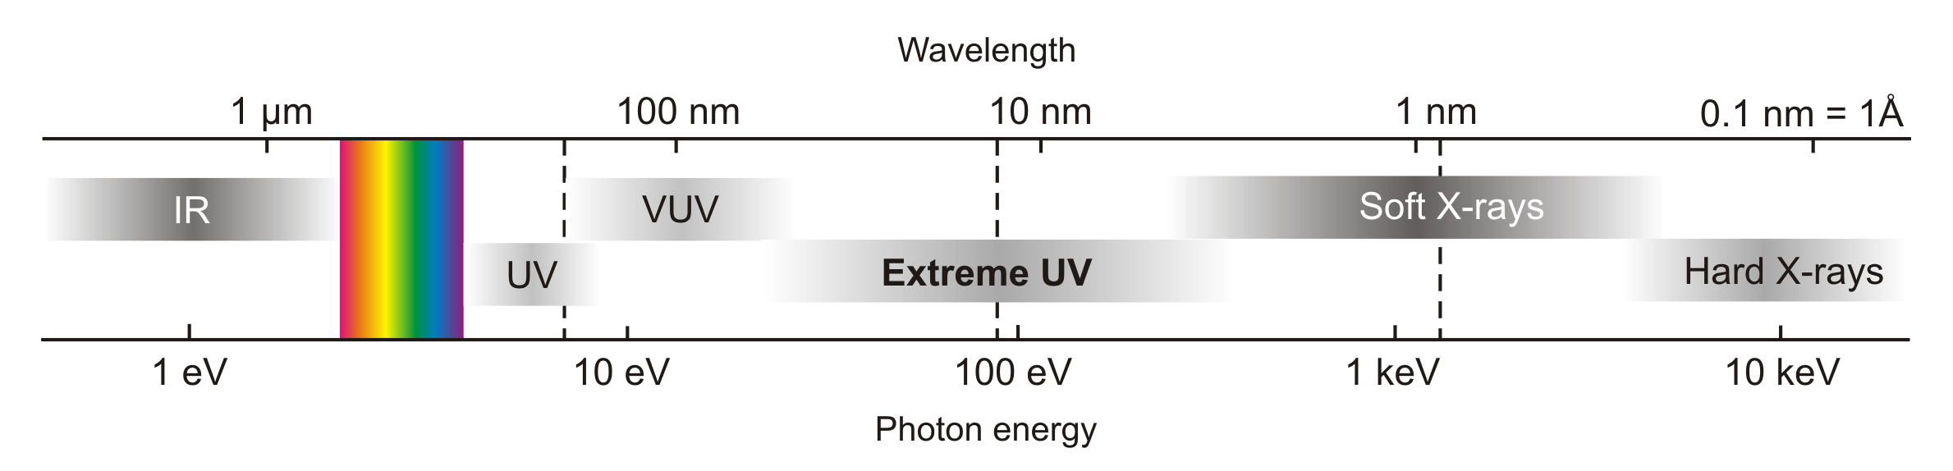
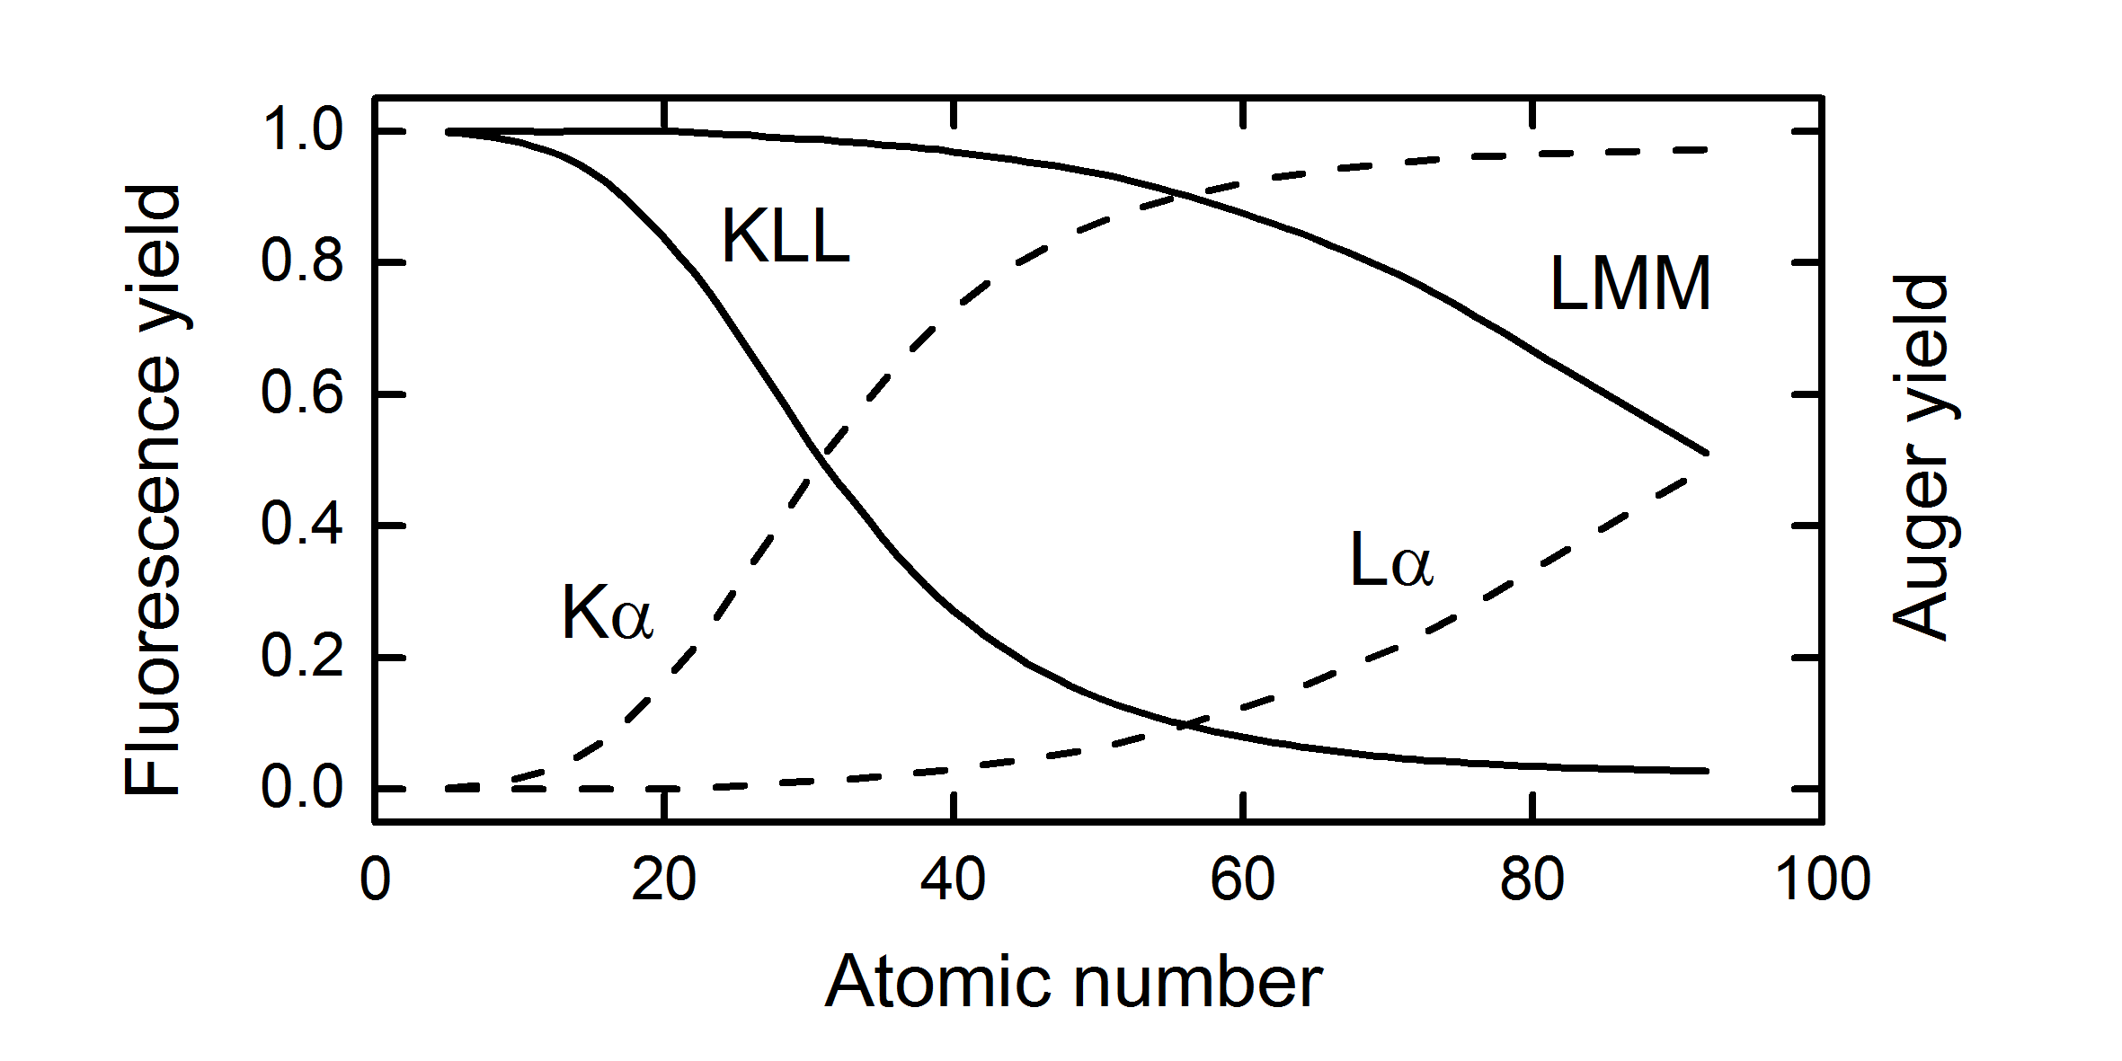
Interaction of XUV and SXR with matter
Radiation very strongly absorbed. Dependent on elemental composition and density of the absorbing specie.
Attenuation length ~ 1 – 10 nm
Interaction exclusively due to the photoelectric
effect followed by Auger electrons emission (low Z)
H₂O

Slide 6
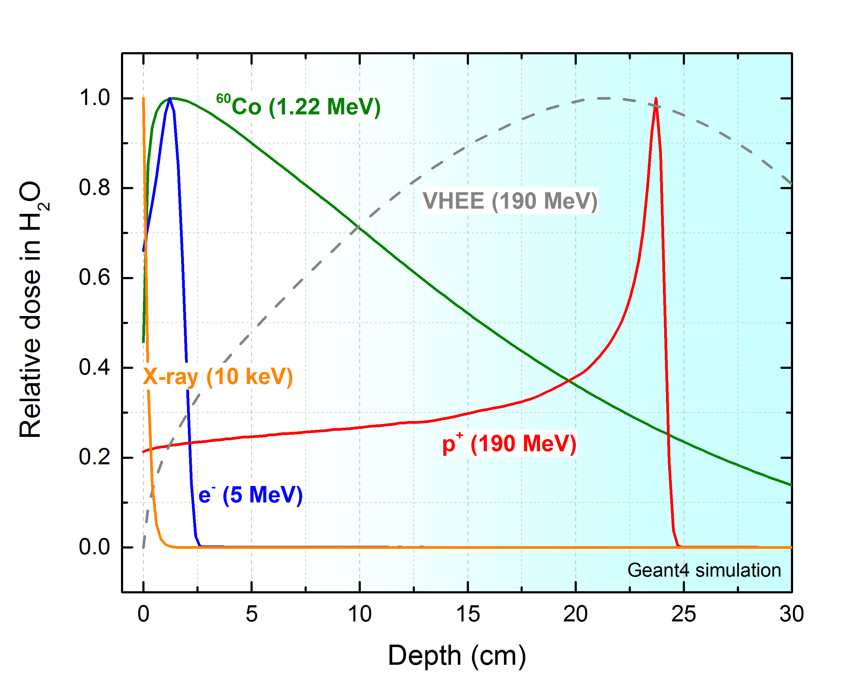
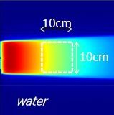
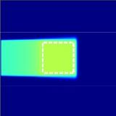
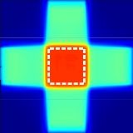
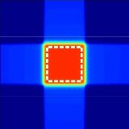
Charged particles vs. photons (gamma)
Penetration depth (dose–depth curve)
Single field irradiation
photons
protons
4 field stereotactic irradiation
photons
protons

Slide 7
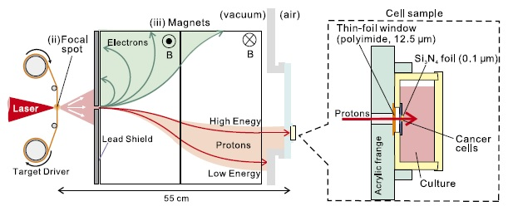
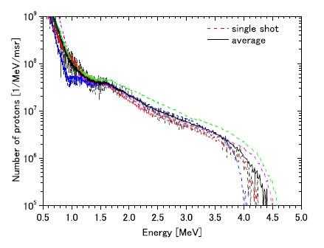
Laser Driven Proton Acceleration (LDPA)
A549 pulmonary adenocarcinoma
γ-H2AX
staining antibody
Yogo, Jpn J ApplPhys 50 (2011)

Slide 8
Outline
Introduction – motivation
Interaction of XUV and SXR with matter
Interaction of charged particles with matter
Experimental sources of XUV/SXR
Biological samples
Interaction of XUV/SXR with DNA
Dosimetry and Radiation chemical yield
Results
Future plans

Slide 9
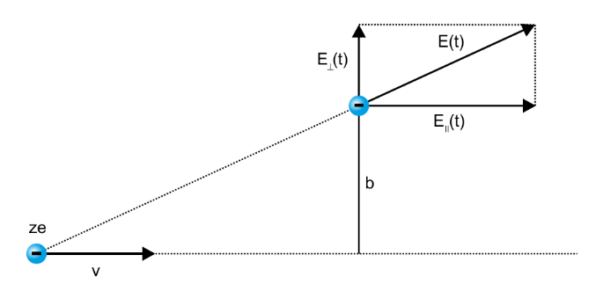
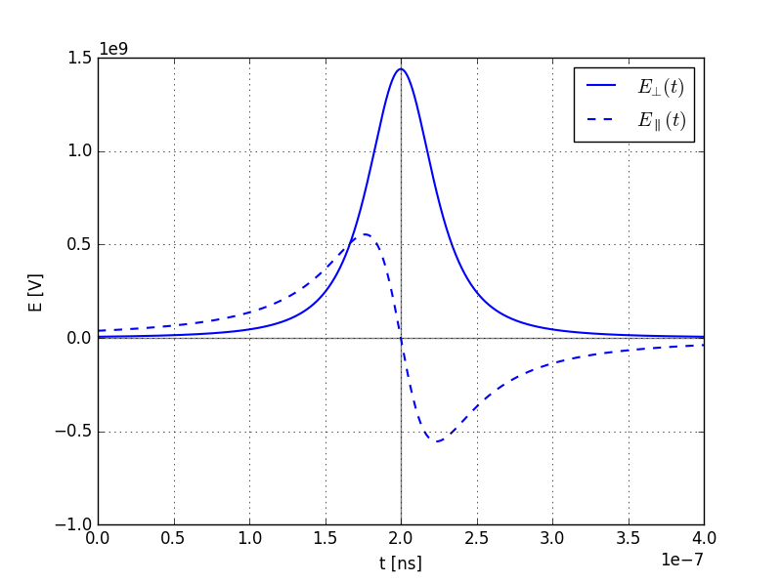
Interaction of charged particles with matter
Soft collisions:
Perpendicular component can be represented by its Fourier transform:
Spectrum may be viewed as a flux of photons with a range of energies with cutoff at:

Slide 10
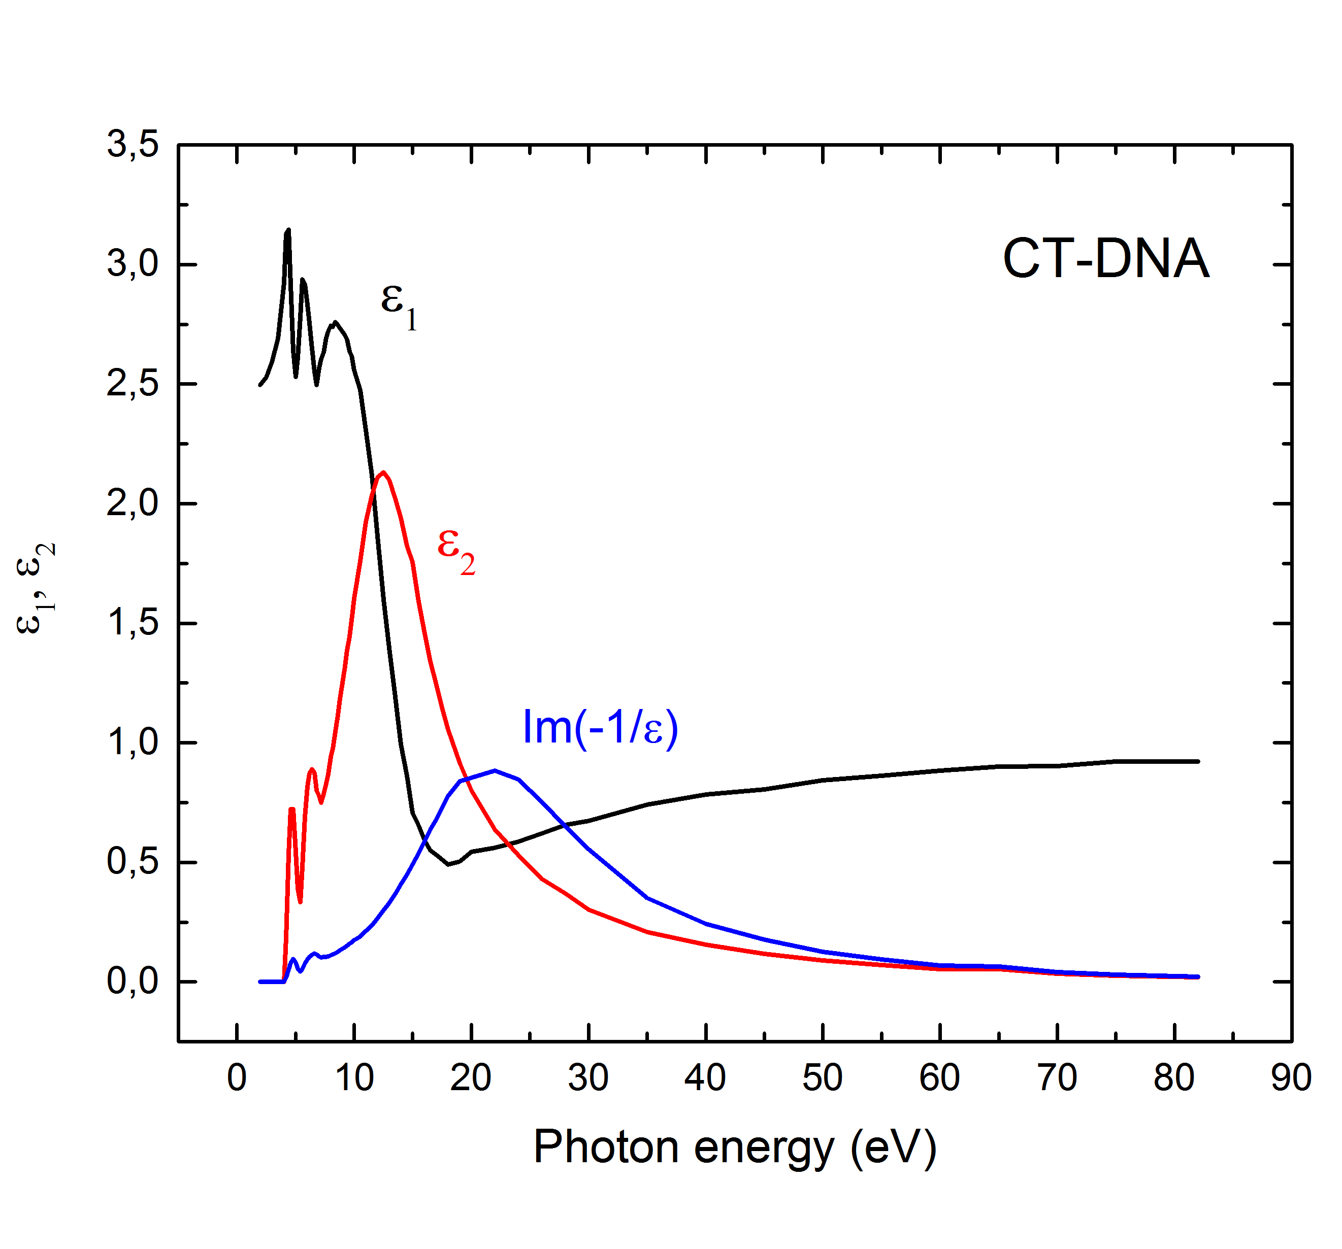
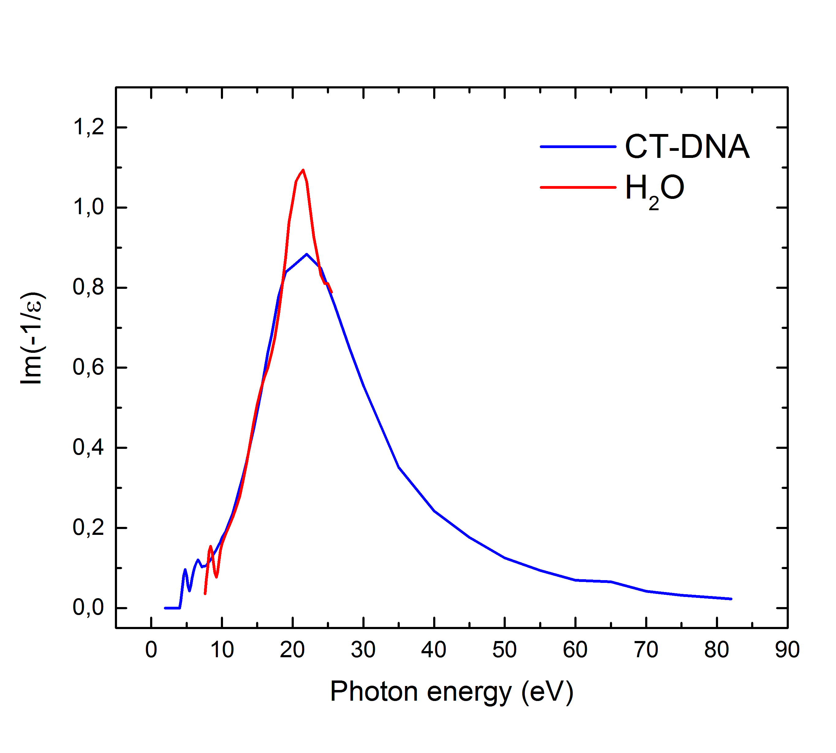

Absorption of Energy in H₂O and DNA
Absorption of energy from photons $∝$
Absorption of energy from fast charge particle $∝$
Energy loss function

Slide 11
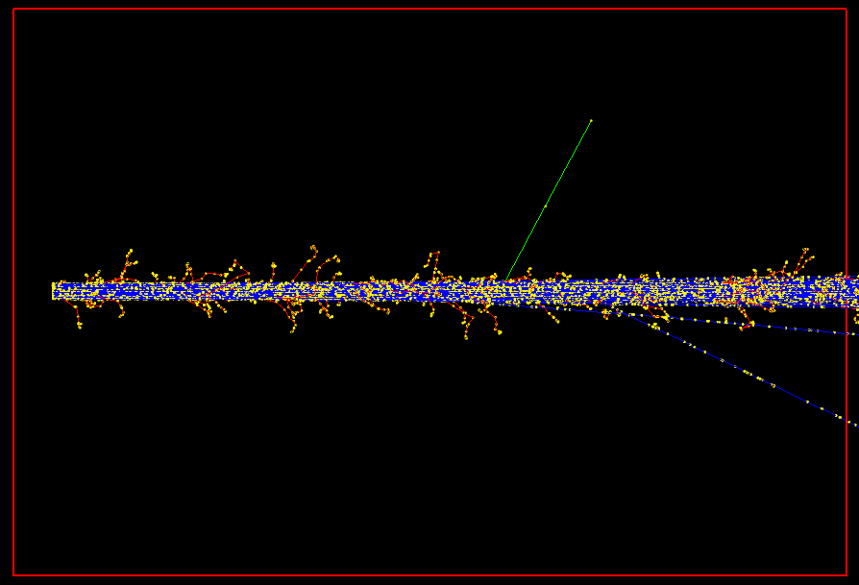
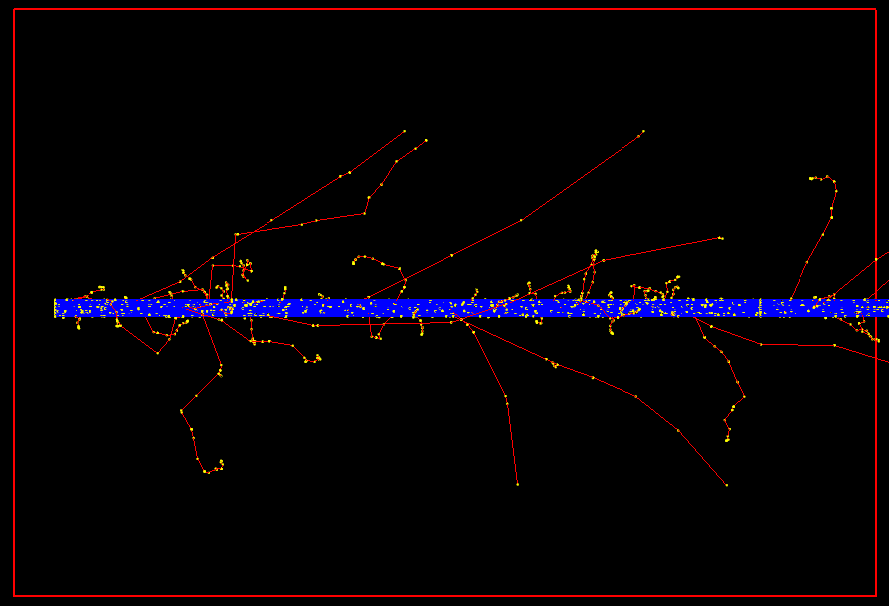
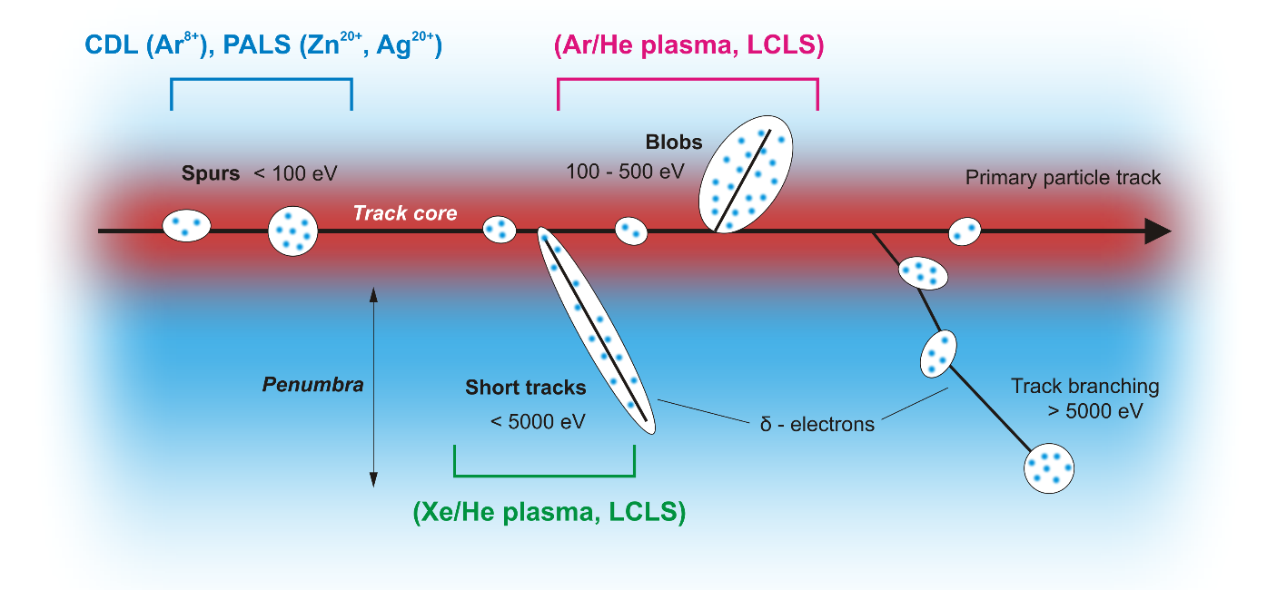
Track Structure of the Fast Charged Particle
Geant4 track simulation - 100 p⁺ in air (30 cm track length)
30 MeV
200 MeV
Track core:
(excitations, ionizations)
Penumbra:
δ-electrons distance (ionizations)
Effects of ionizations and excitations of high density at a timescale of nanoseconds can be simulated using XUV and SXR sources

Slide 12
Outline
Introduction – motivation
Interaction of XUV and SXR with matter
Interaction of charged particles with matter
Experimental sources of XUV/SXR
Biological samples
Interaction of XUV/SXR with DNA
Dosimetry and Radiation chemical yield
Results
Future plans

Slide 13
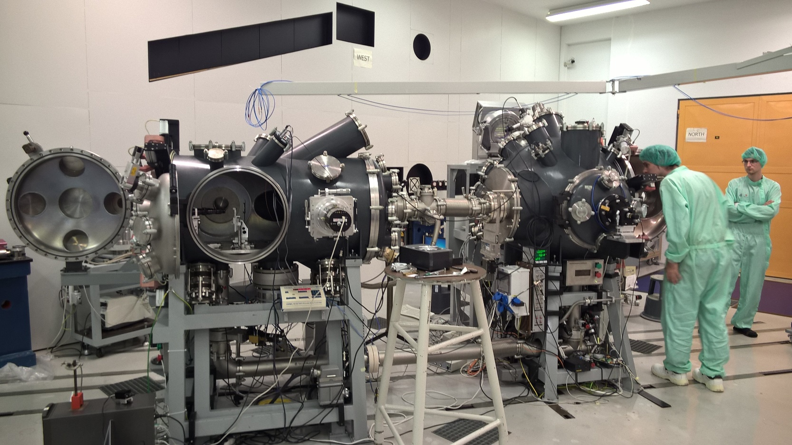
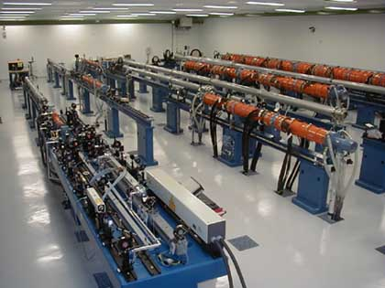
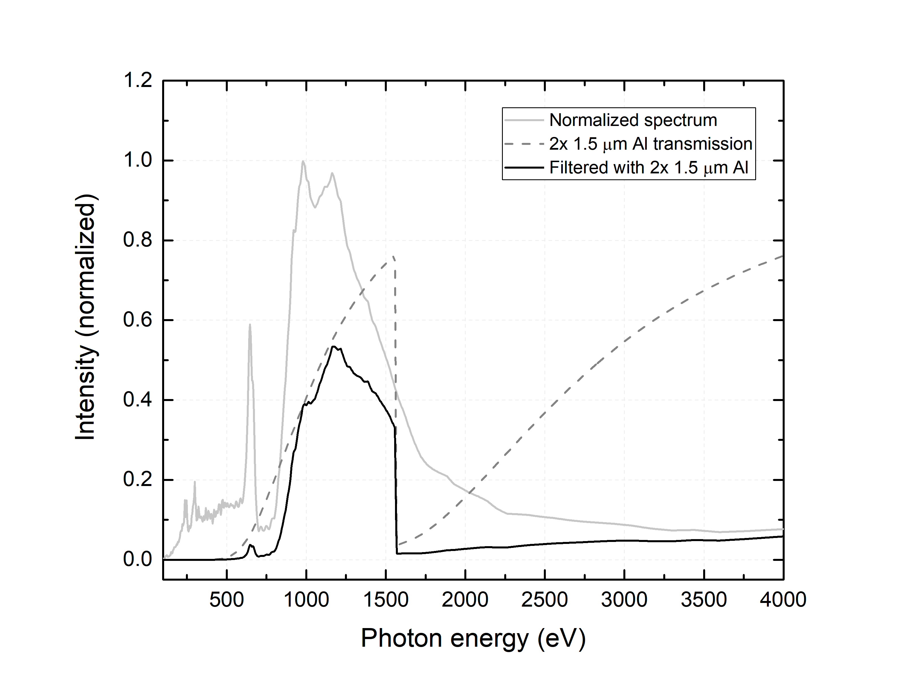
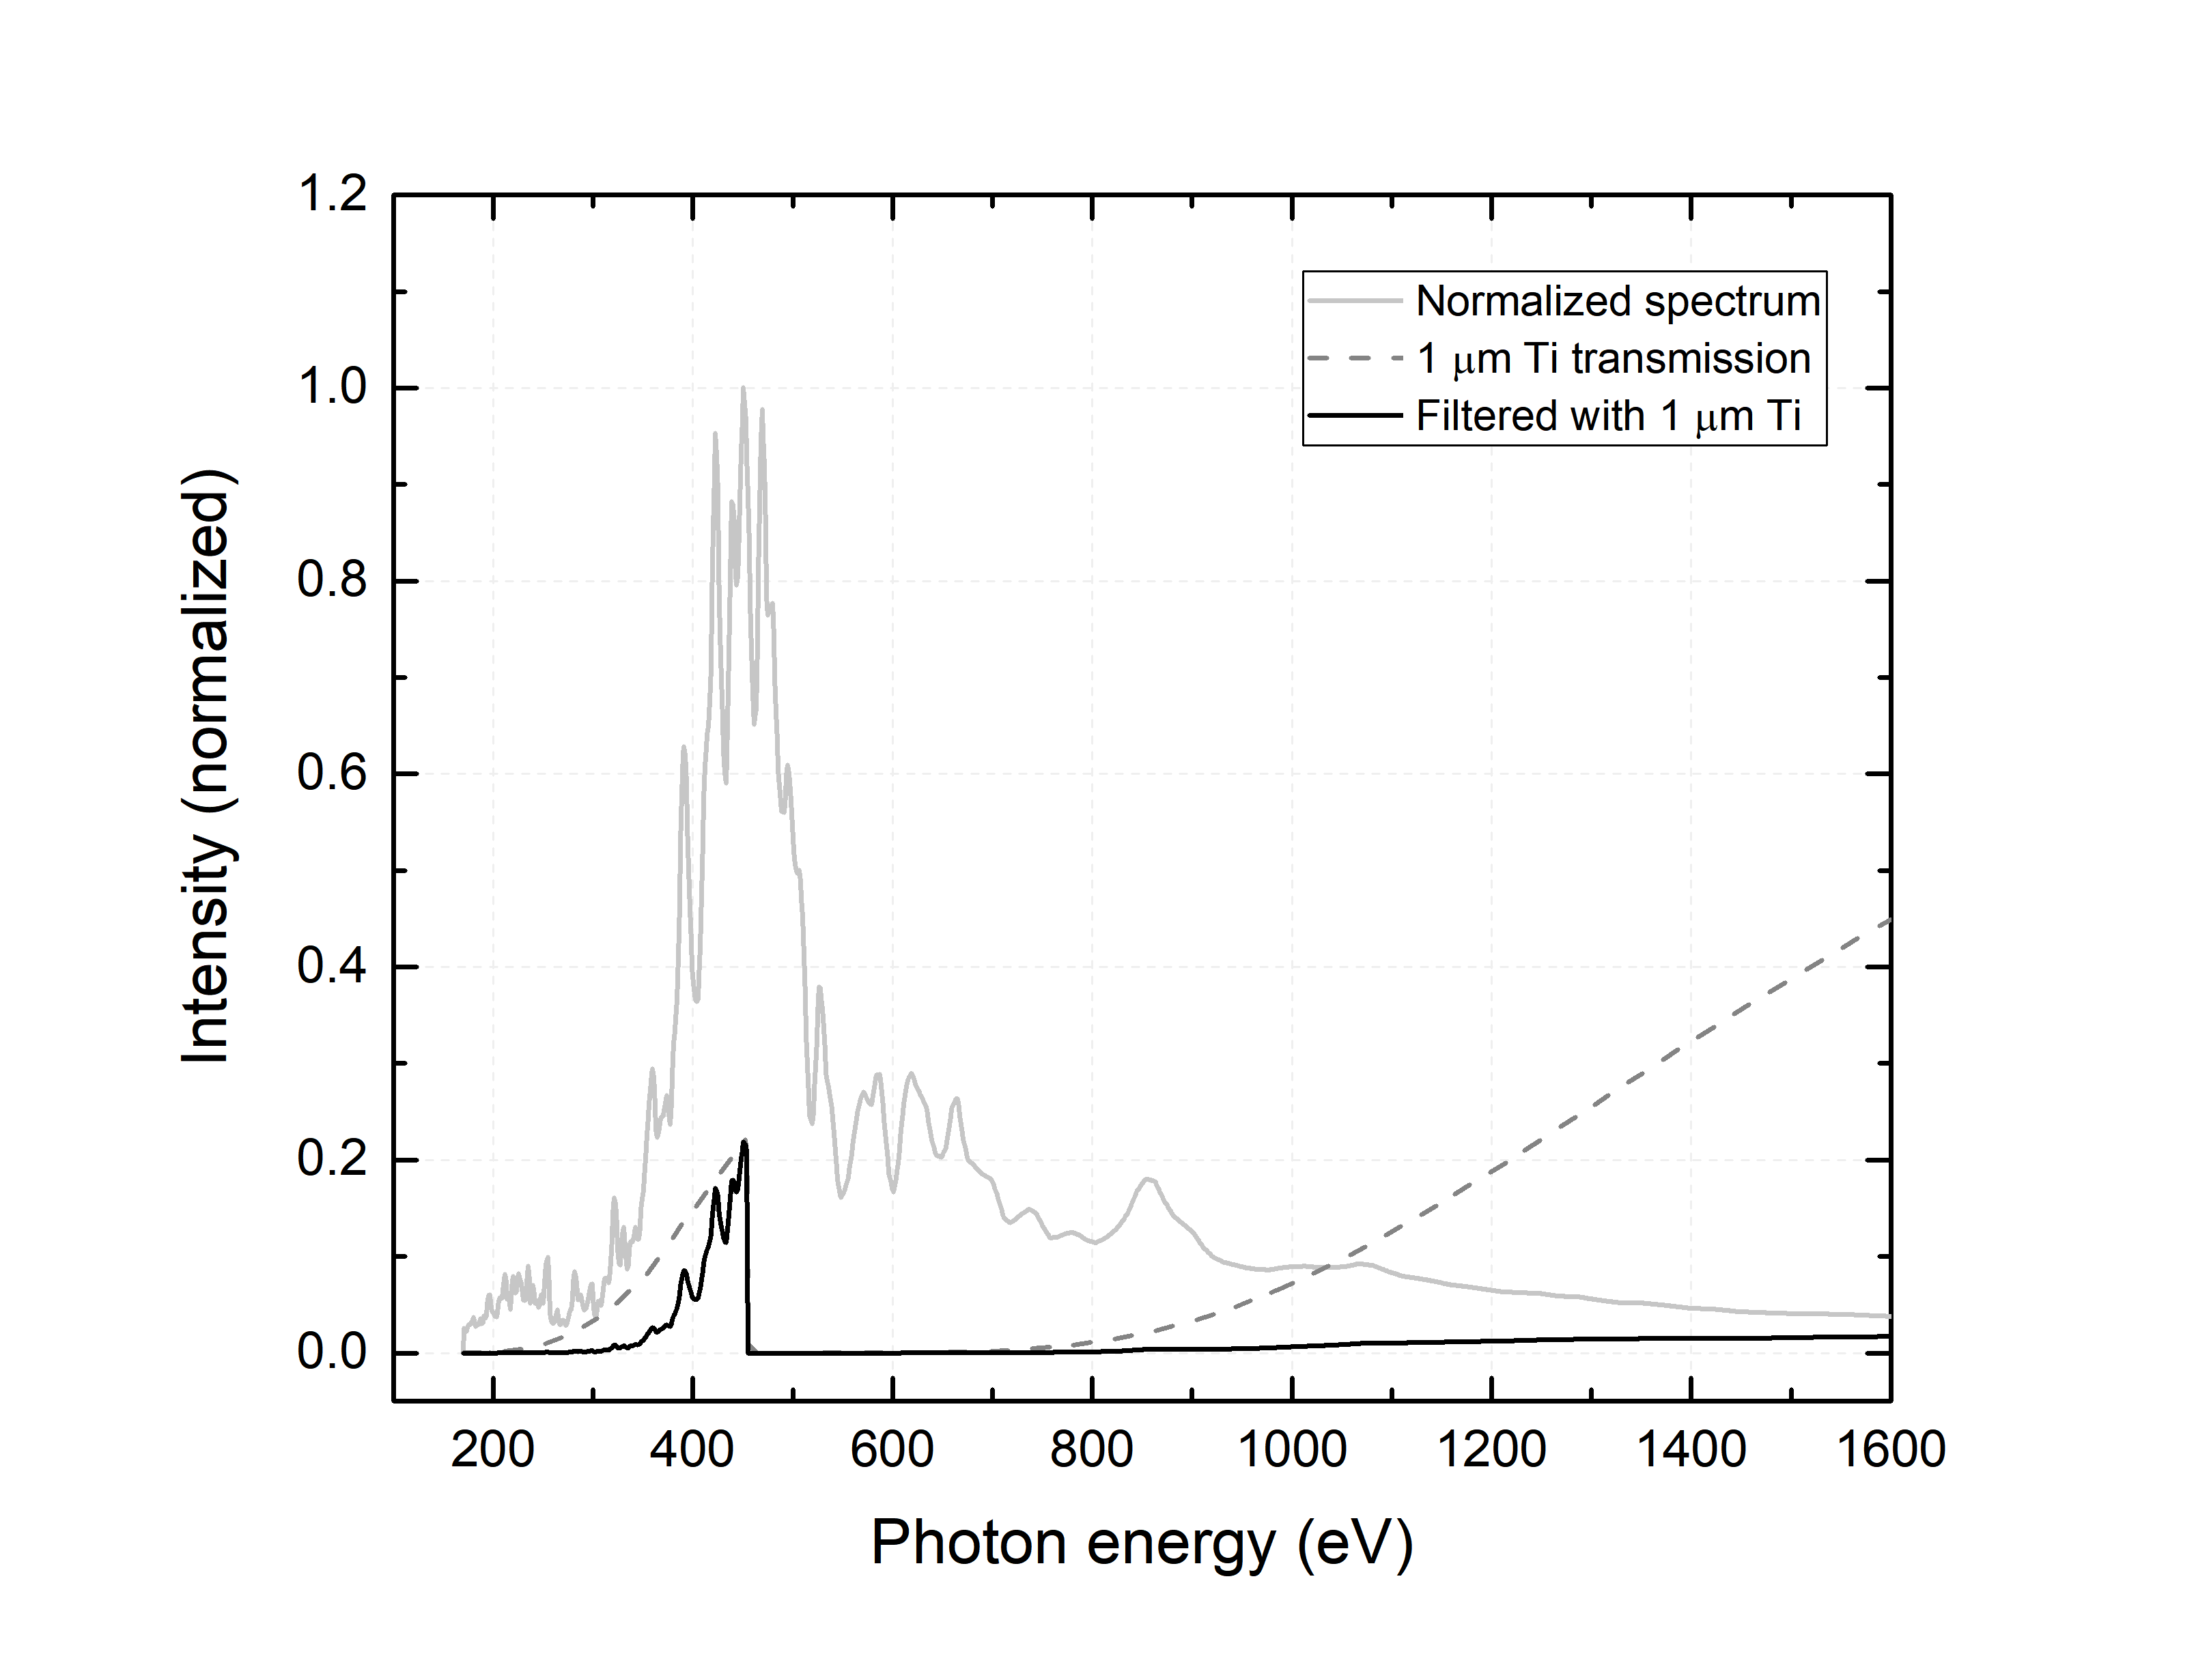
Experimental sources of XUV/SXR
Prague Asterix Laser System: Ar and Xe plasma emission (500 ps)
Xe
Ar

Slide 14
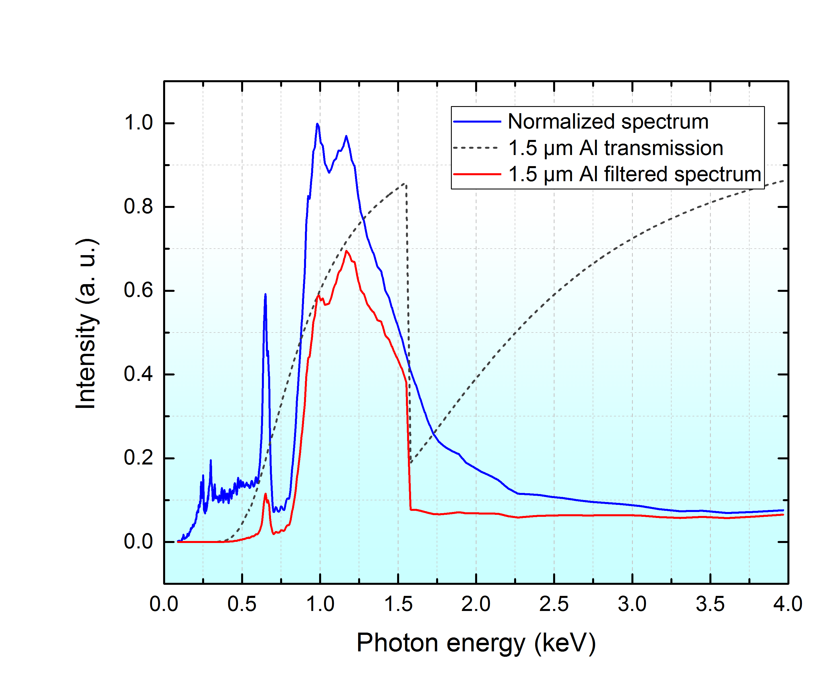
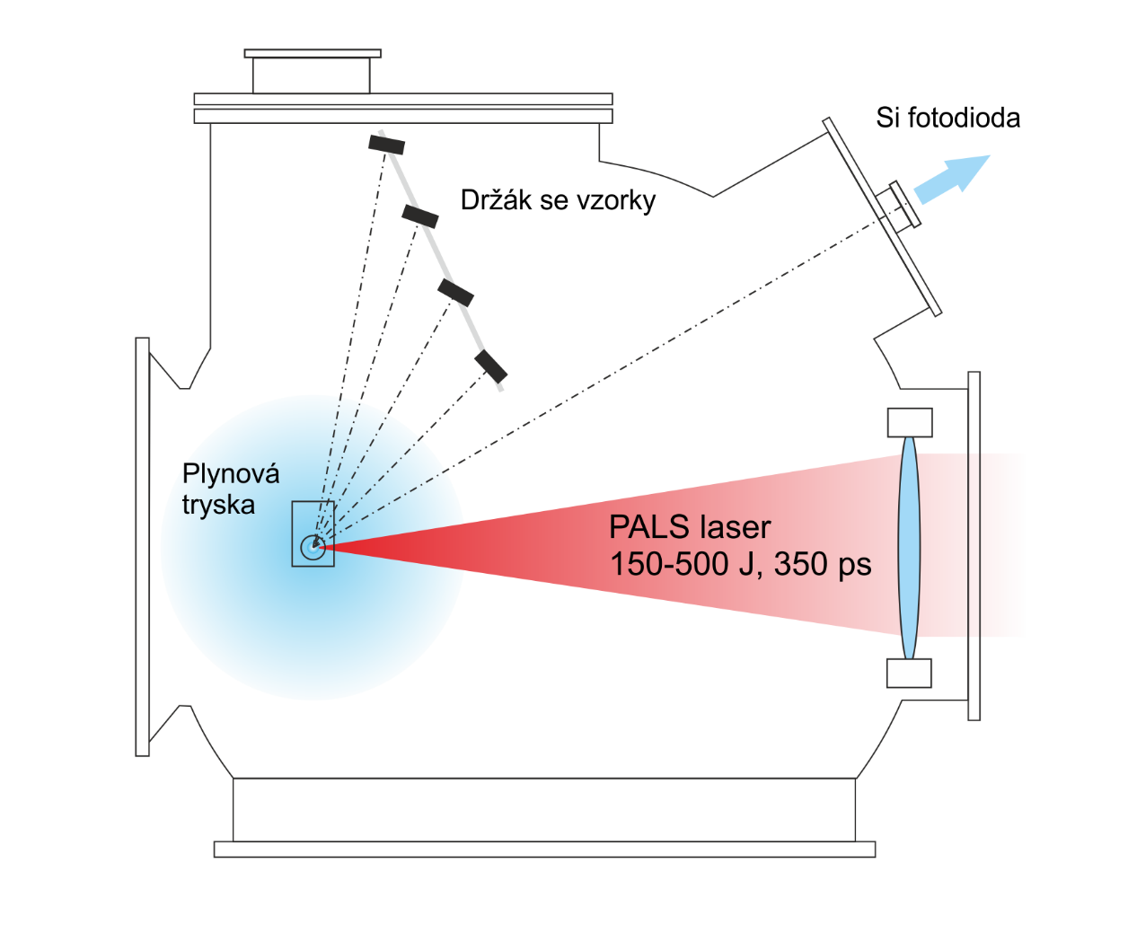
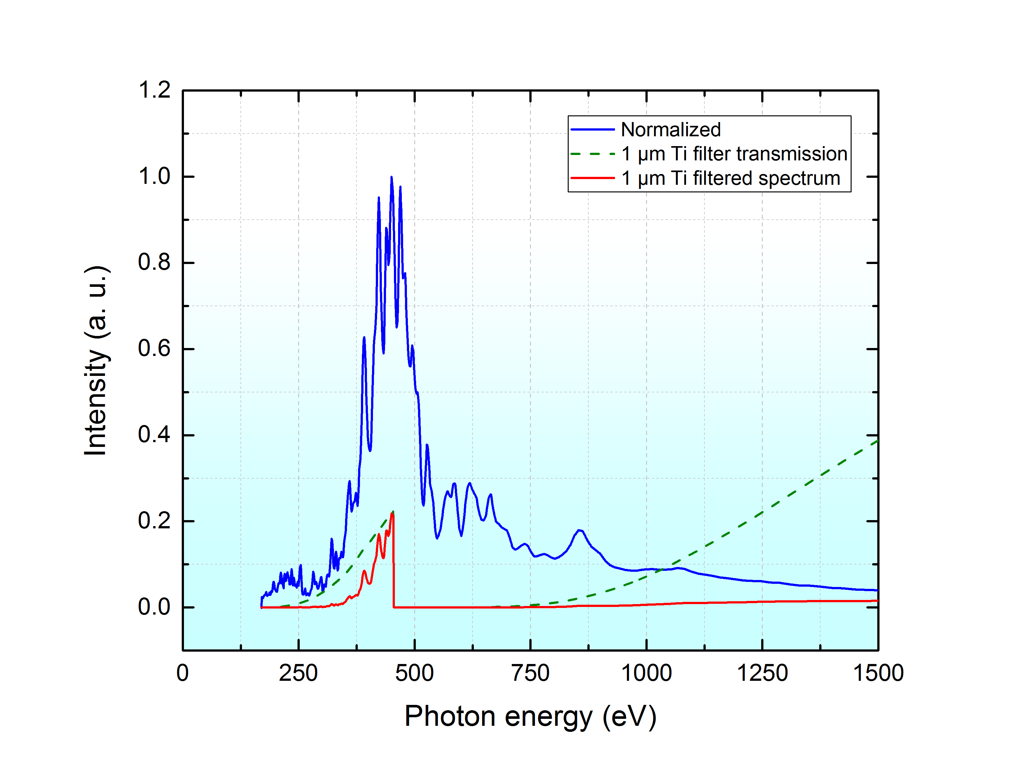
Experimental sources of XUV/SXR
PALS (Prague Asterix Laser System) – SXR (250 – 1570 eV)
Xe/He plasma
Gas puff target
Ar/He plasma

Slide 15
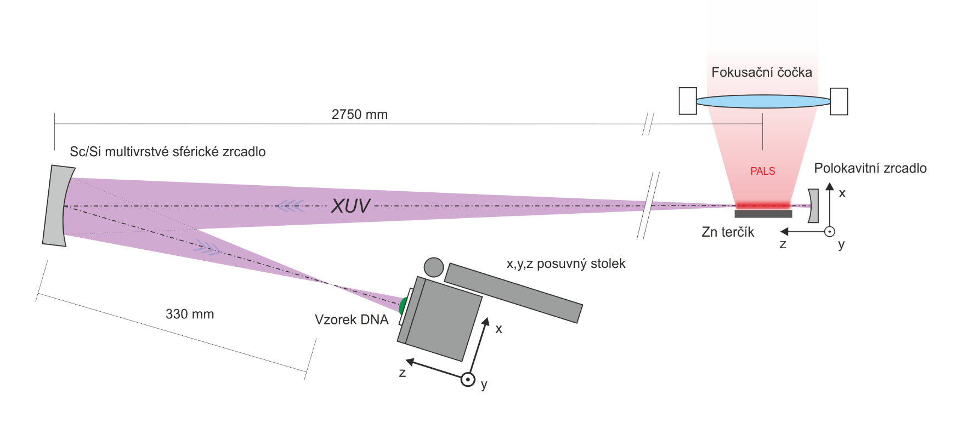
Experimental sources of XUV/SXR
PALS (Prague Asterix Laser System) – SXR (250 – 1570 eV)
Zn target – QSS (Ne-like zinc)
Wavelength: 21.2 nm (58.5 eV)

Slide 16
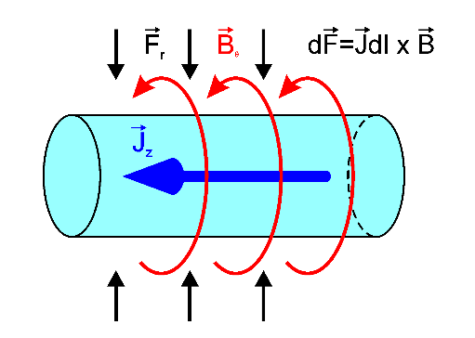
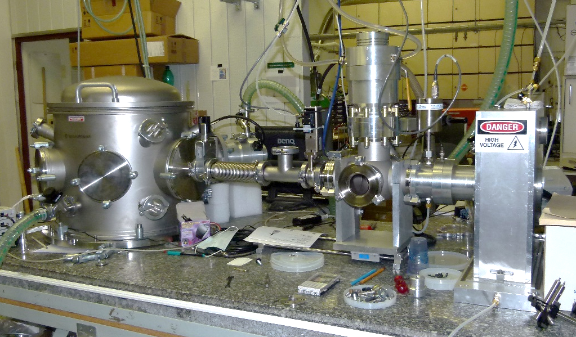
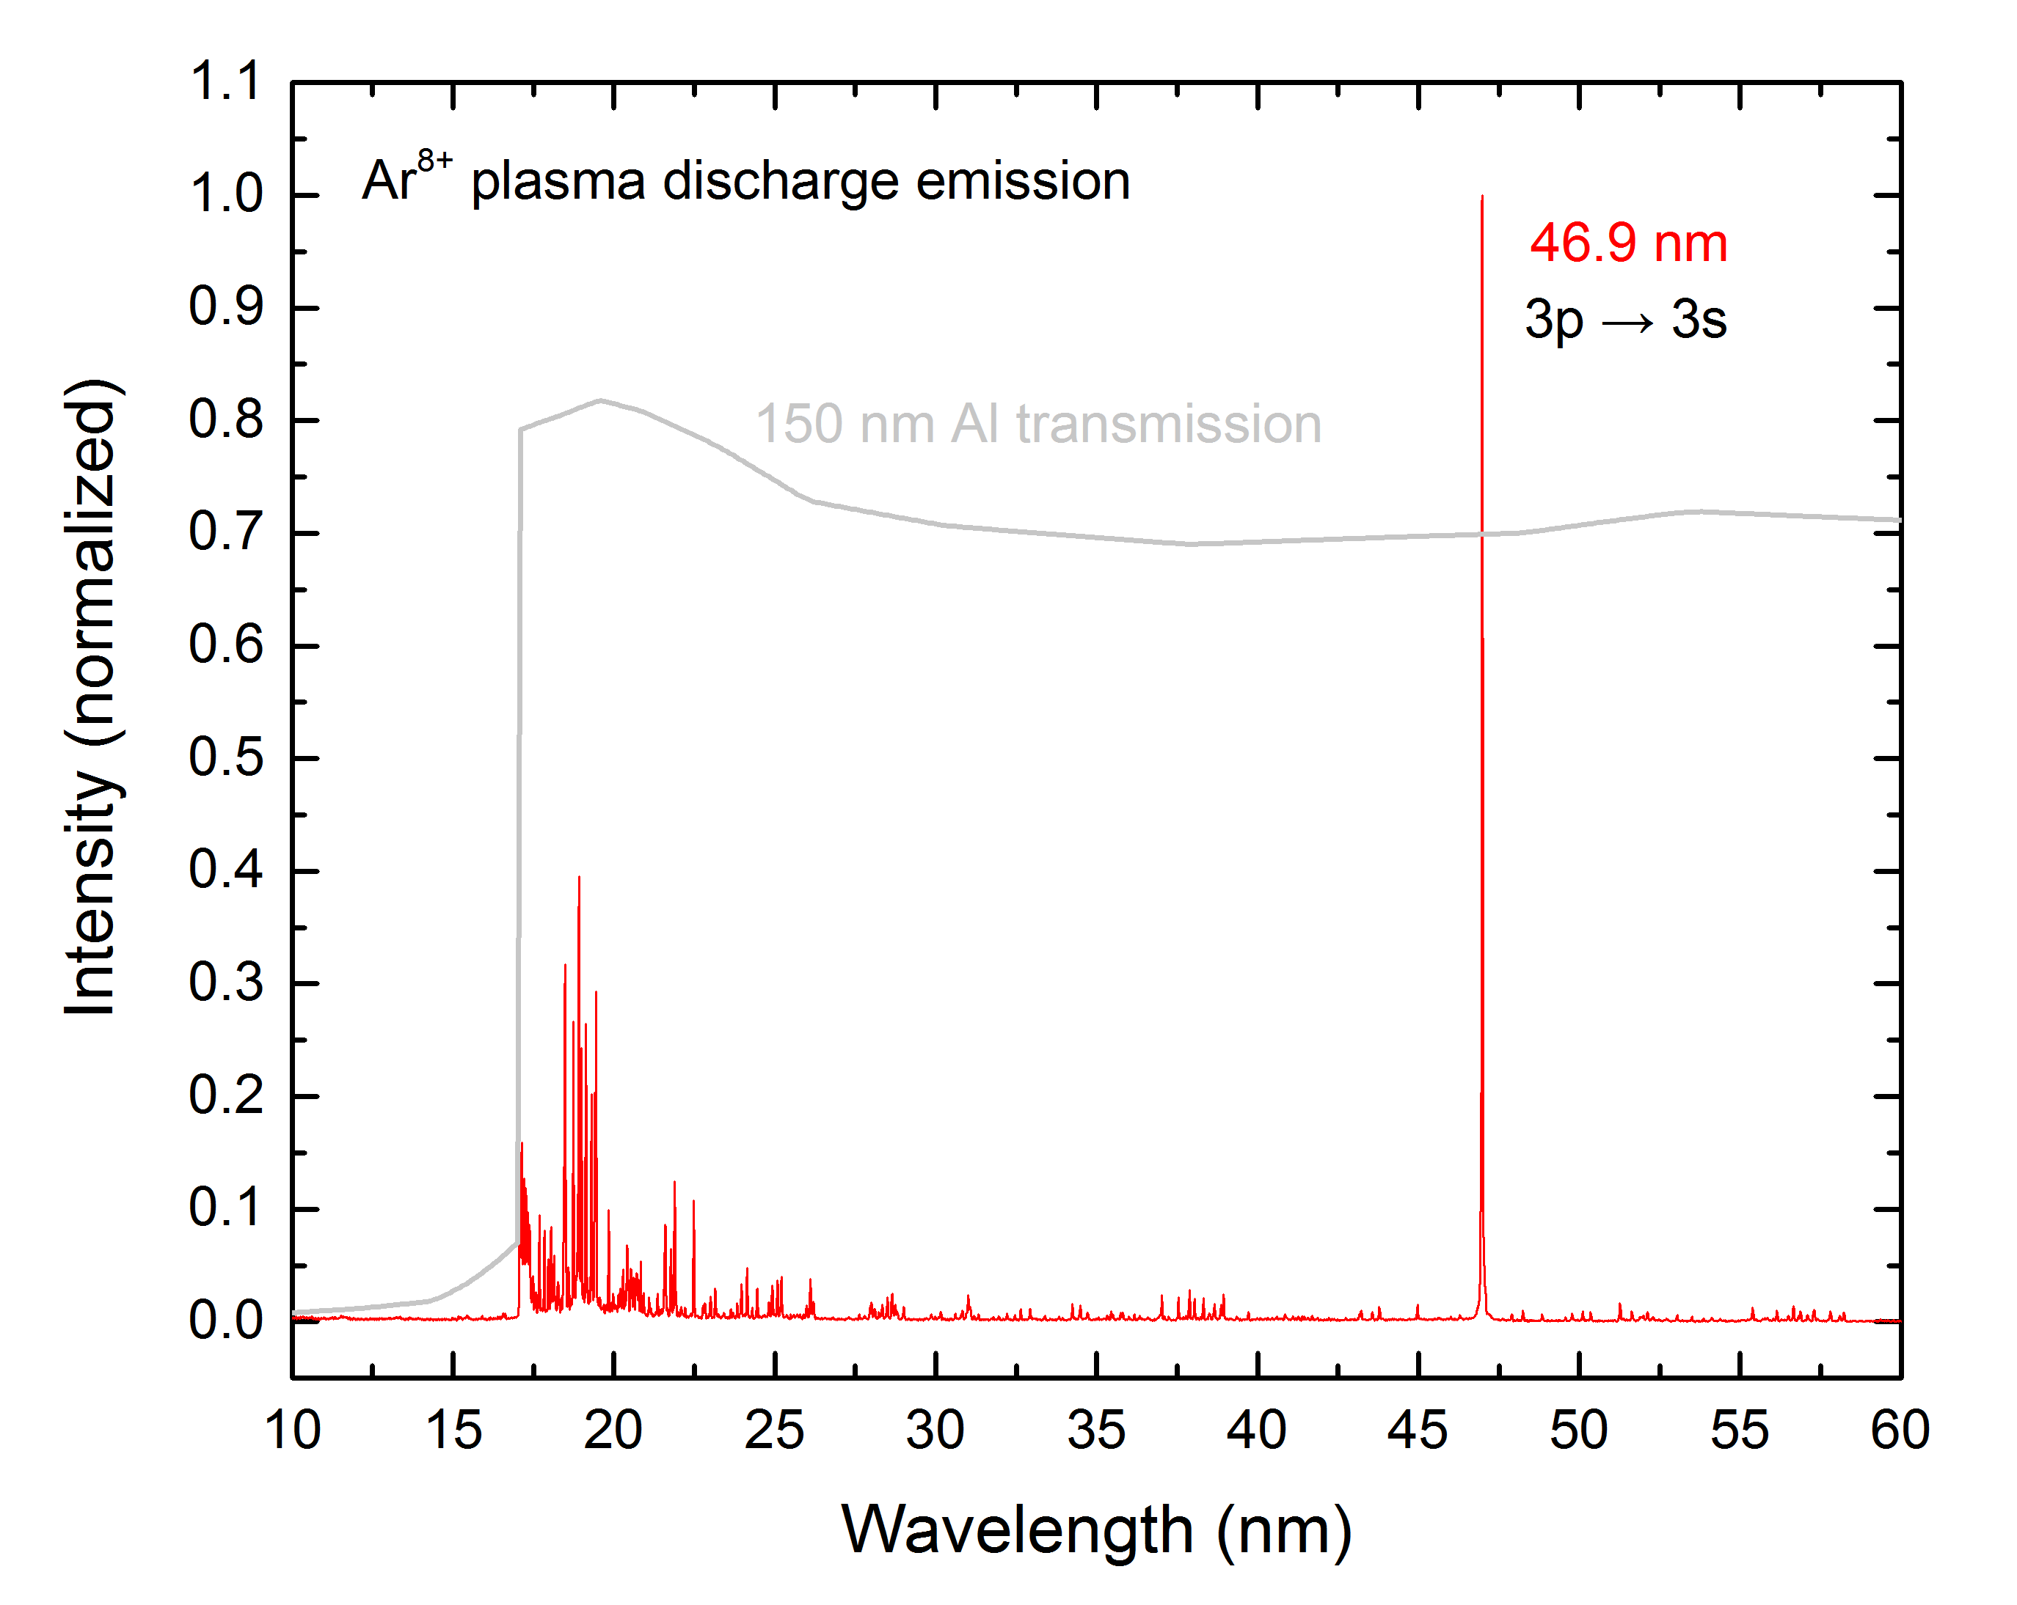
Experimental sources of XUV/SXR
Extreme UV (XUV) capillary discharge laser (IOP CAS)
Ne-like Ar⁸⁺ capillary discharge laser (CDL)
Laser emission by Z-pinch effect of Ar⁸⁺ plasma (Pulsed source)
Laser transition between ¹S₀(2p_{1/2}3p_{1/2})_{J=0} a ¹P₁(2p_{1/2}3s_{1/2})_{J=1} states
S. Heinbuch et al.: Optics Express 13, 4050 (2006)

Slide 17
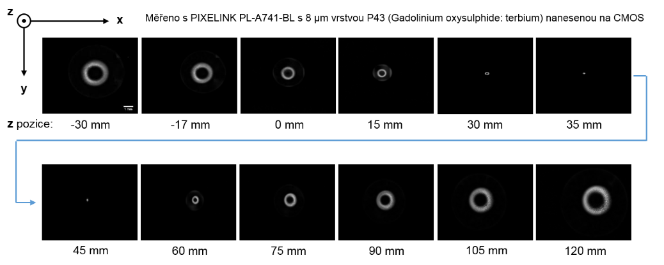
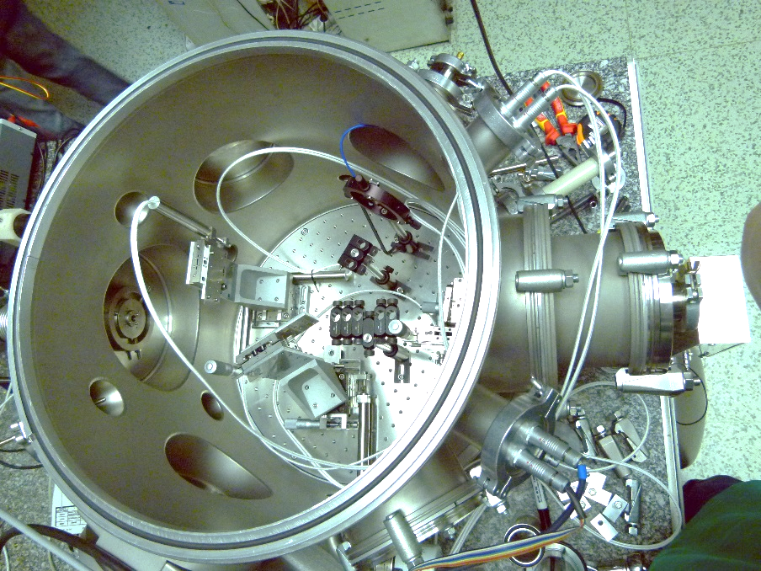
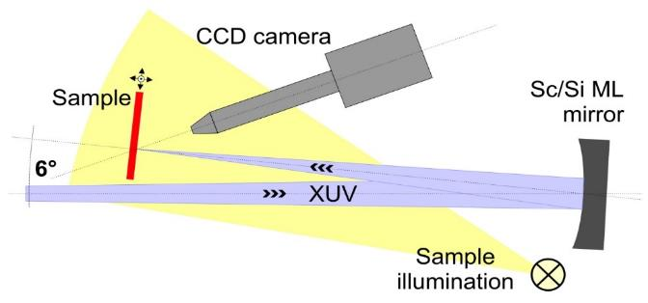

Experimental sources of XUV/SXR
Extreme UV (XUV) capillary discharge laser (IOP CAS)
XUV beam
$$I\left(x,y\right)={\left\{I_{0}∙\left[\frac{{(x−x_{0})}^{2}+{(y−y_{0})}^{2}}{w^{2}}\right]∙exp\left[−2\frac{{(x−x_{0})}^{2}+{(y−y_{0})}^{2}}{w^{2}}\right]\right\}}^{n}$$
Output characteristics
Wavelength | 46.9 nm
Δλ/λ | 8x10⁻⁴
Pulse length | 2 ns (FWHM)
Pulse energy | 1 μJ
Rep. rate | 12 Hz (3 Hz)

Slide 18
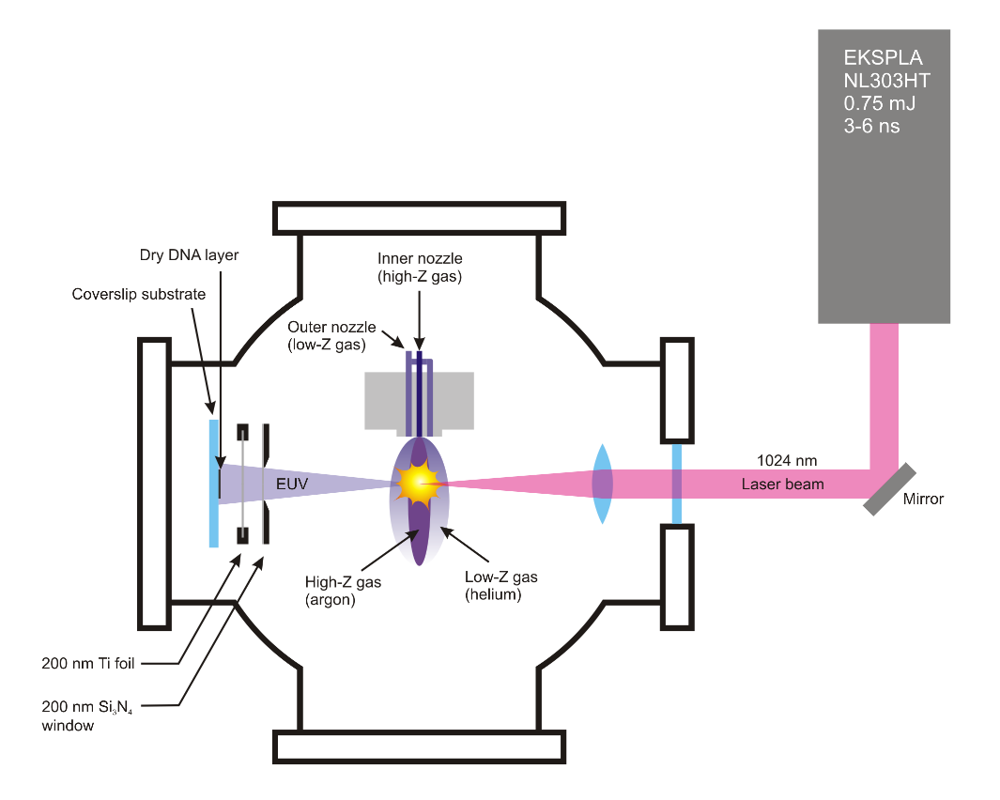
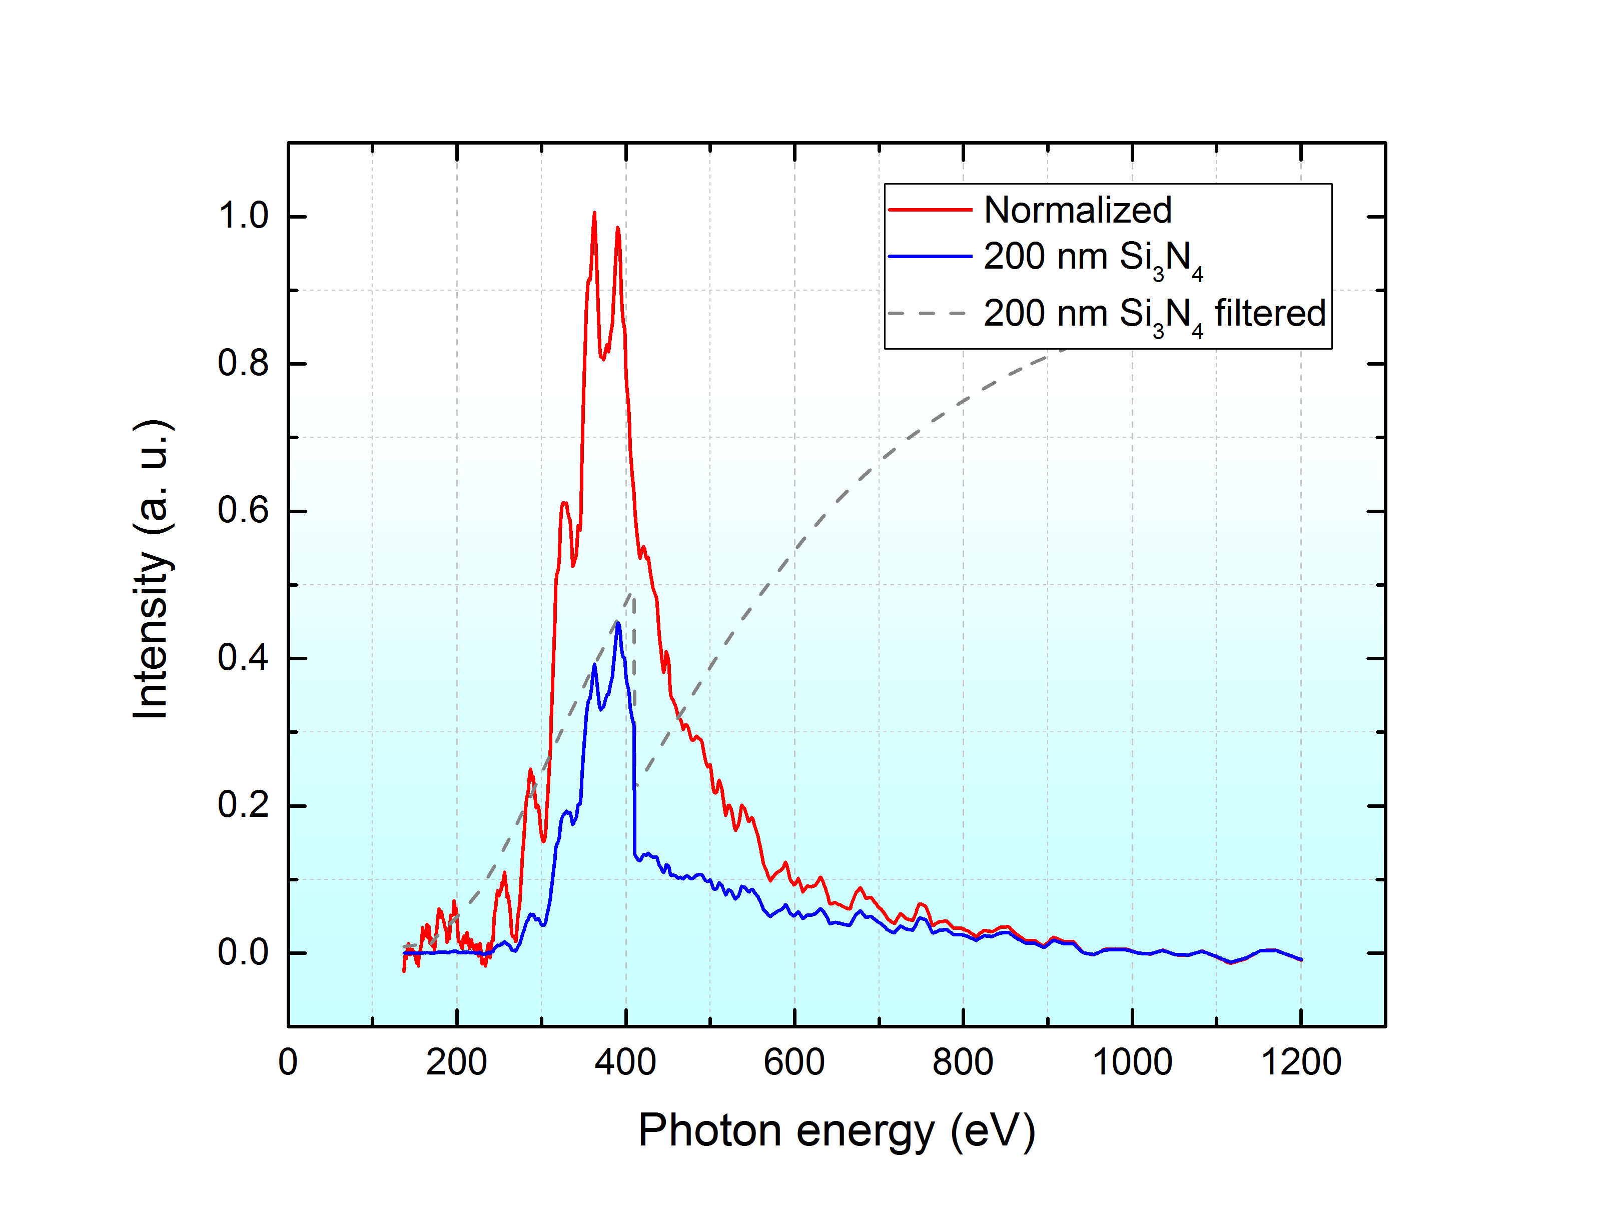
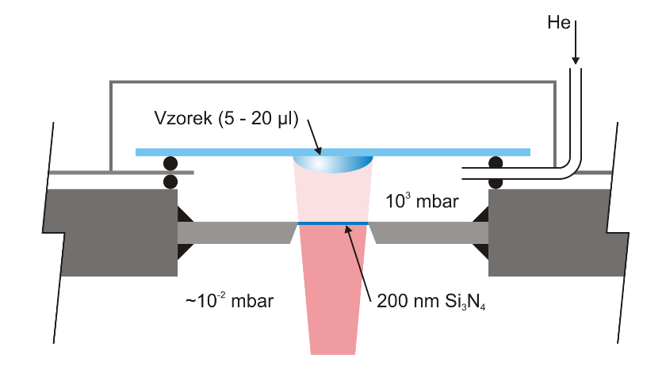
Experimental sources of XUV/SXR
Source of soft X-ray radiation in “water window “ energy range (WAT)
Nd: YAG Laser: 1024 nm, 0.75 J, 4 ns, 10 Hz, rep. rate: 30 Hz
He cell:
Ar plasma emission: 4.2 x 10¹⁴ photons/m² per pulse at sample position (in vacuum chamber)

Slide 19
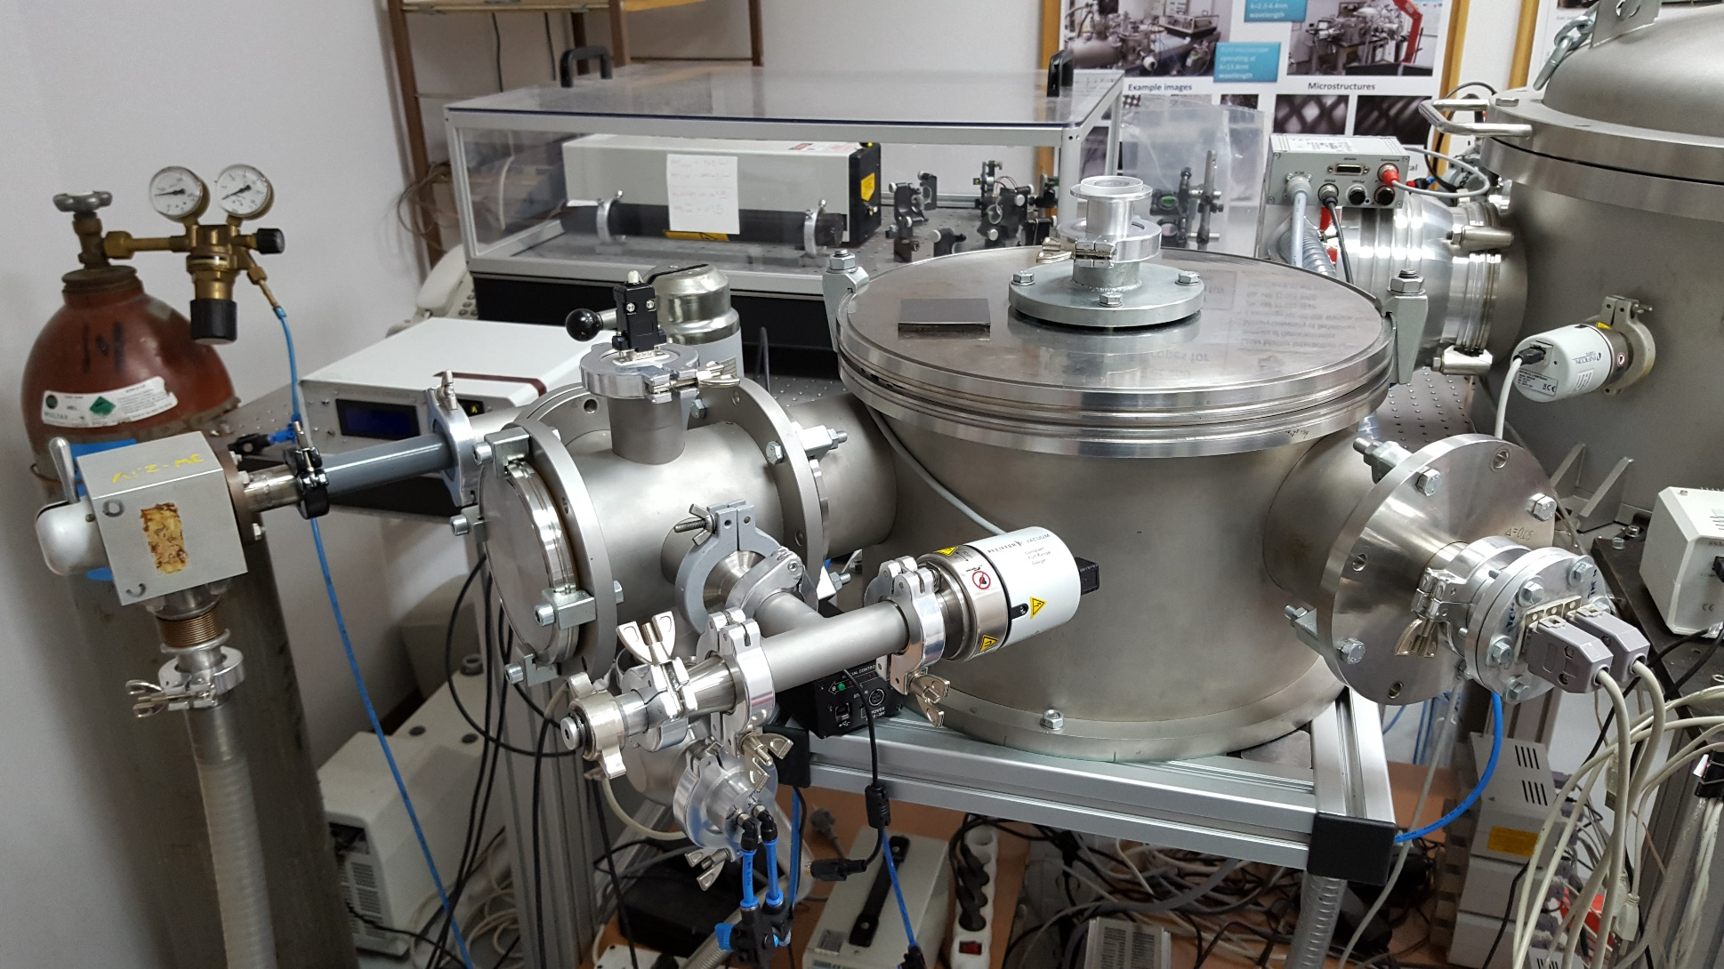
Radiation sources
IOE - MUT: Ar plasma emission (5 ns)
D. Adjei et al.: Rad Phys Chem 120, 17 (2016)

Slide 20
Outline
Introduction – motivation
Interaction of XUV and SXR with matter
Interaction of charged particles with matter
Experimental sources of XUV/SXR
Biological samples
Interaction of XUV/SXR with DNA
Dosimetry and Radiation chemical yield
Results
Future plans

Slide 21
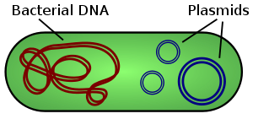
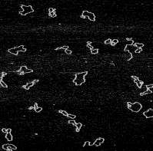
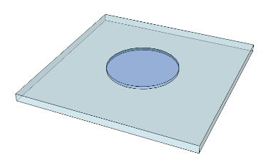
DNA Samples
Plasmid DNA: extracted circular nucleic acid molecule (4361 bp long) M = 2.86×10⁶ Da
AFM
⁶⁰Co gamma (1.25 MeV)
Stabilized by TE buffer (Tris-HCl:EDTA in different ratios)
Dried in N₂ atmosphere
© Egor Ukraintsev, PhD
21

Slide 22
Outline
Introduction – motivation
Interaction of XUV and SXR with matter
Interaction of charged particles with matter
Experimental sources of XUV/SXR
Biological samples
Interaction of XUV/SXR with DNA
Dosimetry and Radiation chemical yield
Results
Future plans

Slide 23
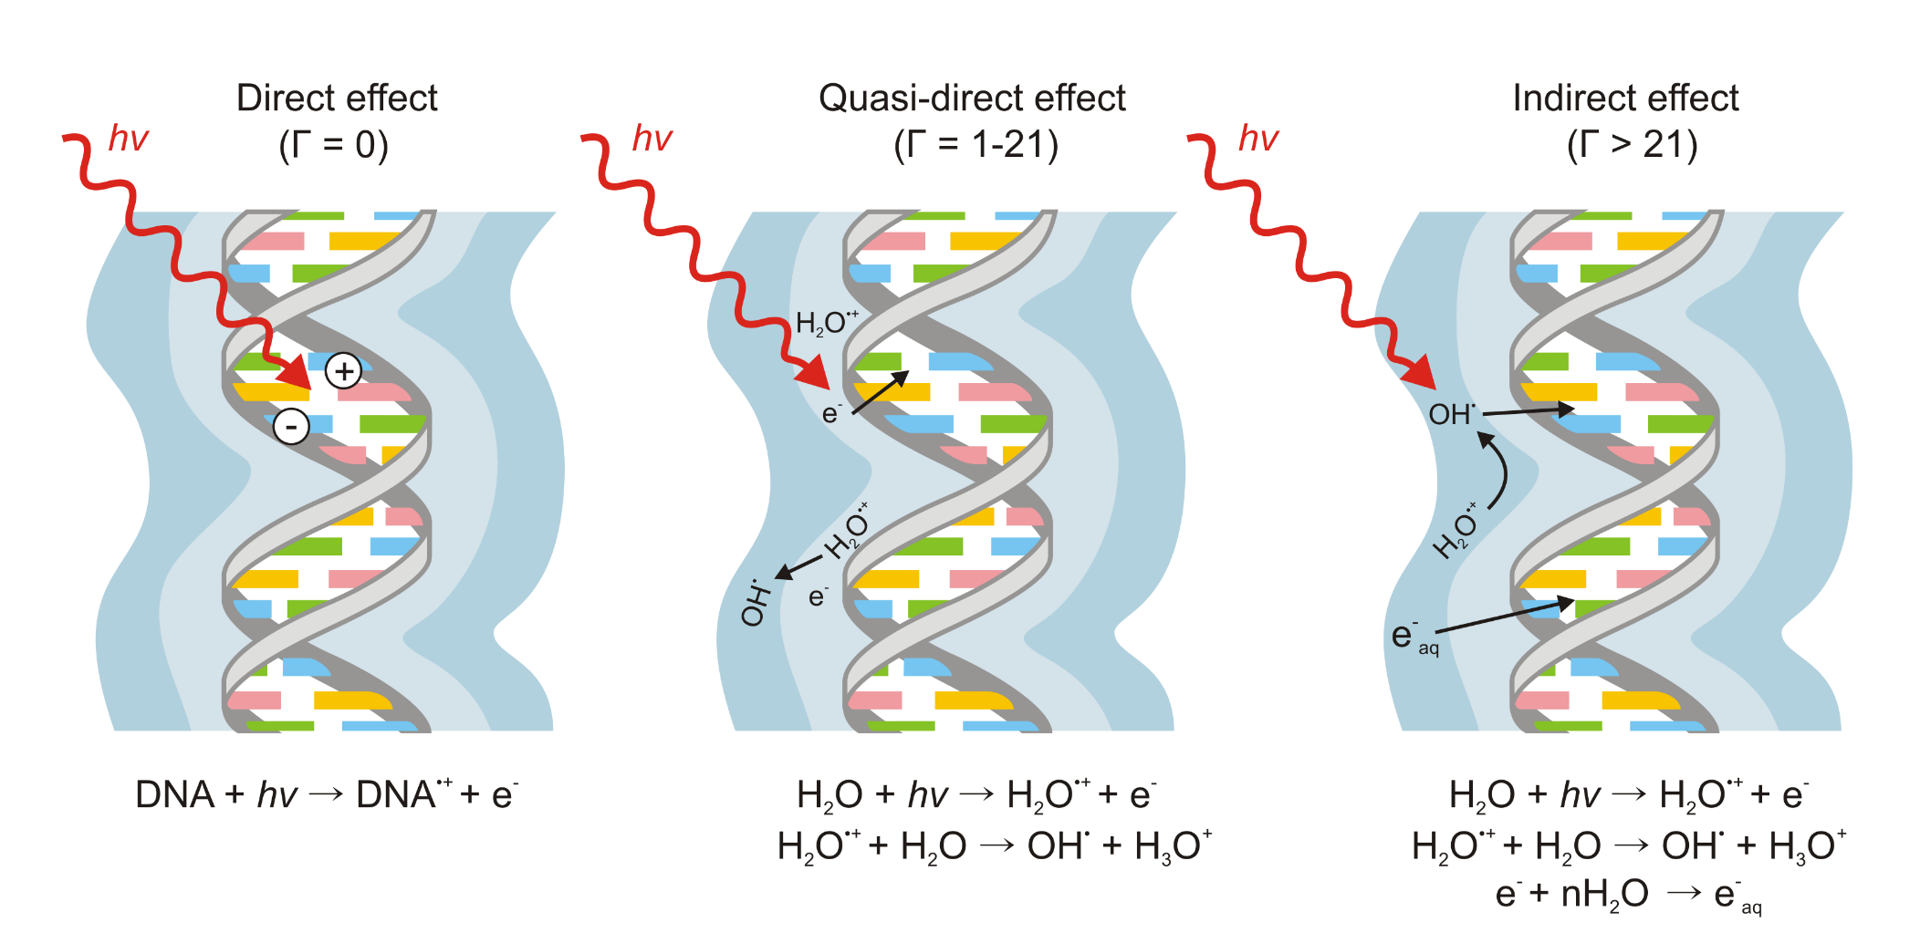
Interaction of XUV/SXR with DNA
Plasmid DNA: direct vs. indirect effect
Adhikary A., Electron spin resonance of radicals in irradiated DNA. (2014)

Slide 24
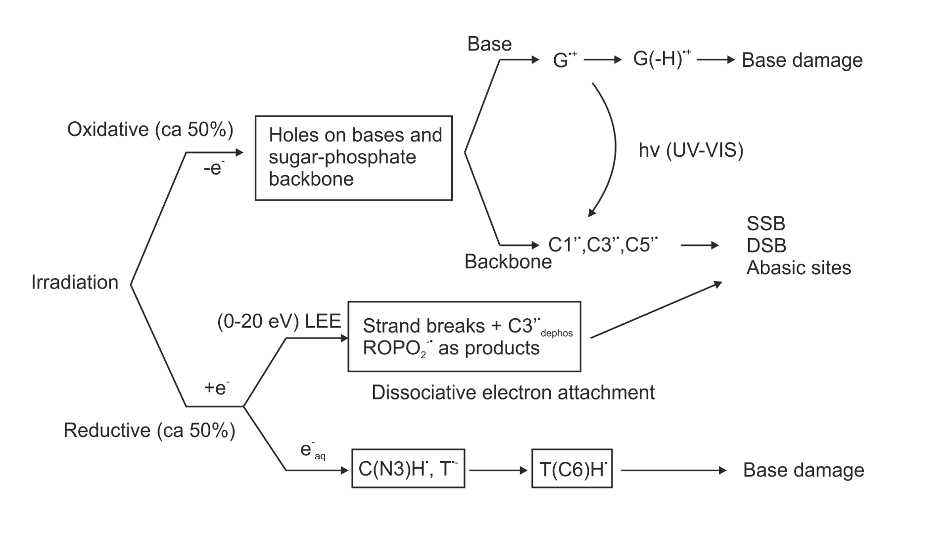
Interaction of XUV/SXR with DNA
DNA damage pathway
Adhikary A., Electron spin resonance of radicals in irradiated DNA. (2014)

Slide 25
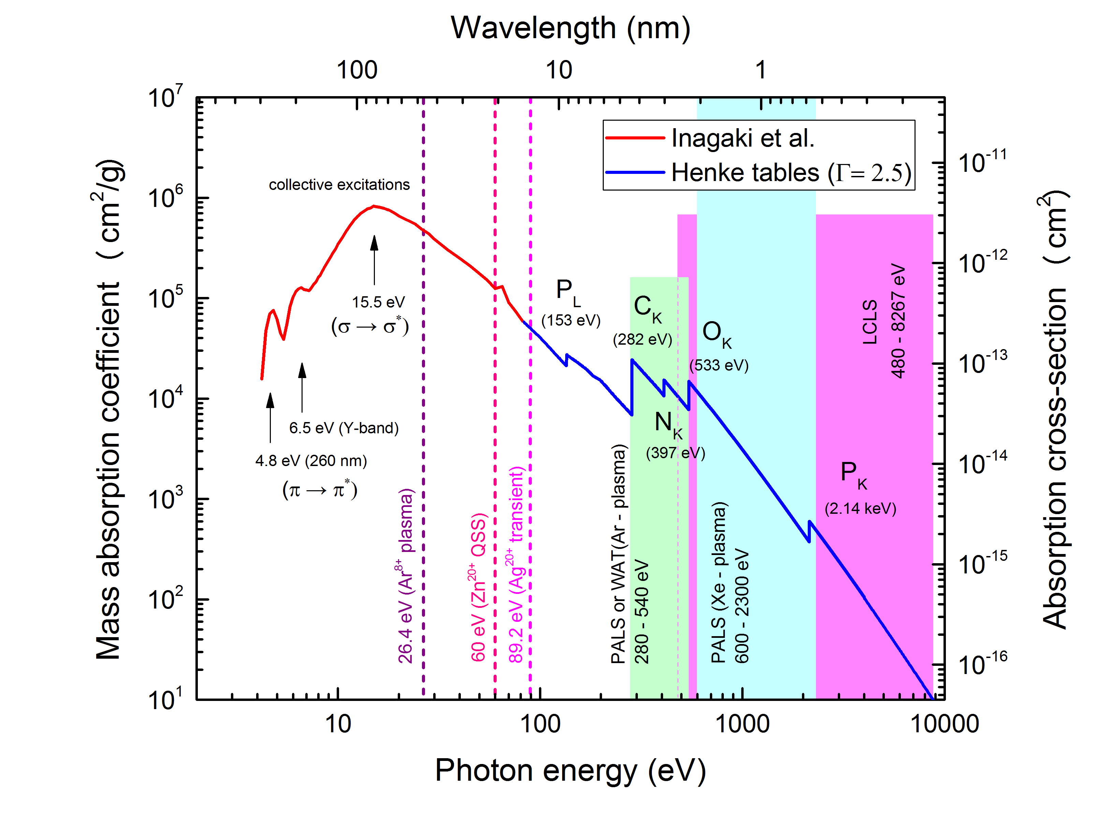
Absorption of DNA in electromagnetic spectrum
Plasmid DNA: pBR322 (4361 bp)
Optical constants:
π → π* excitation of heterocycles of bases (4.7 eV až ~6.5 eV): T-T (T-C) dimers in far UV (<8 eV)
σ – excitations connected with sugar-phosphate backbone (> 7.8 eV)
σ → σ* excitation of bases (13.8 eV)
dR + hv → dR• leads to SSBs and DSBs (the yield of DSBs rise with the secondary electrons energy)

Slide 26
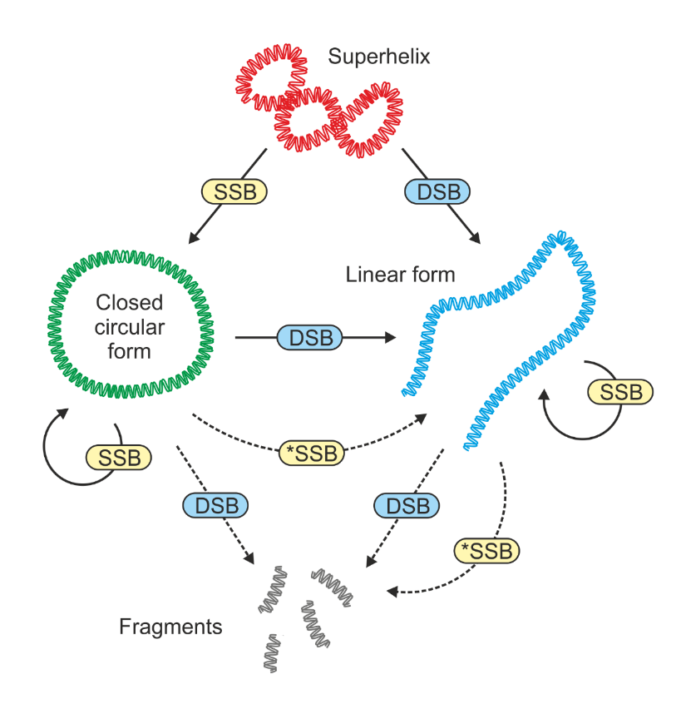
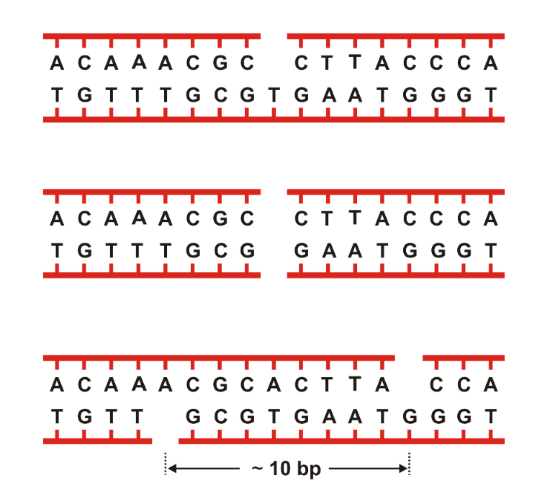
Interaction of XUV/SXR Radiation with DNA
Effects of XUV (46.9 nm) on plasmid DNA breakage demonstrated:
Nováková et al.: Phys. Rev. E 91 (4), 042718, 2015
SSB
DSB
SSB*

Slide 27
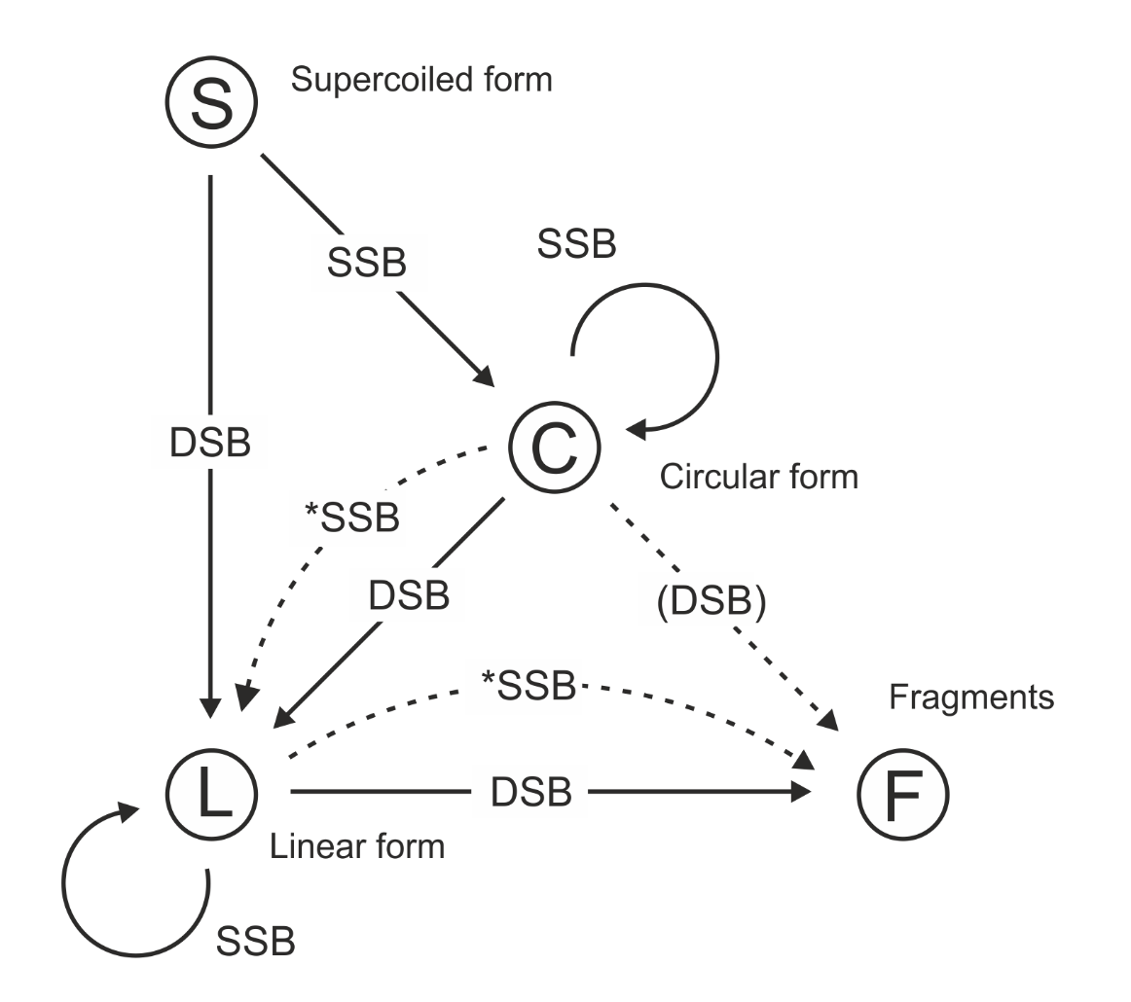
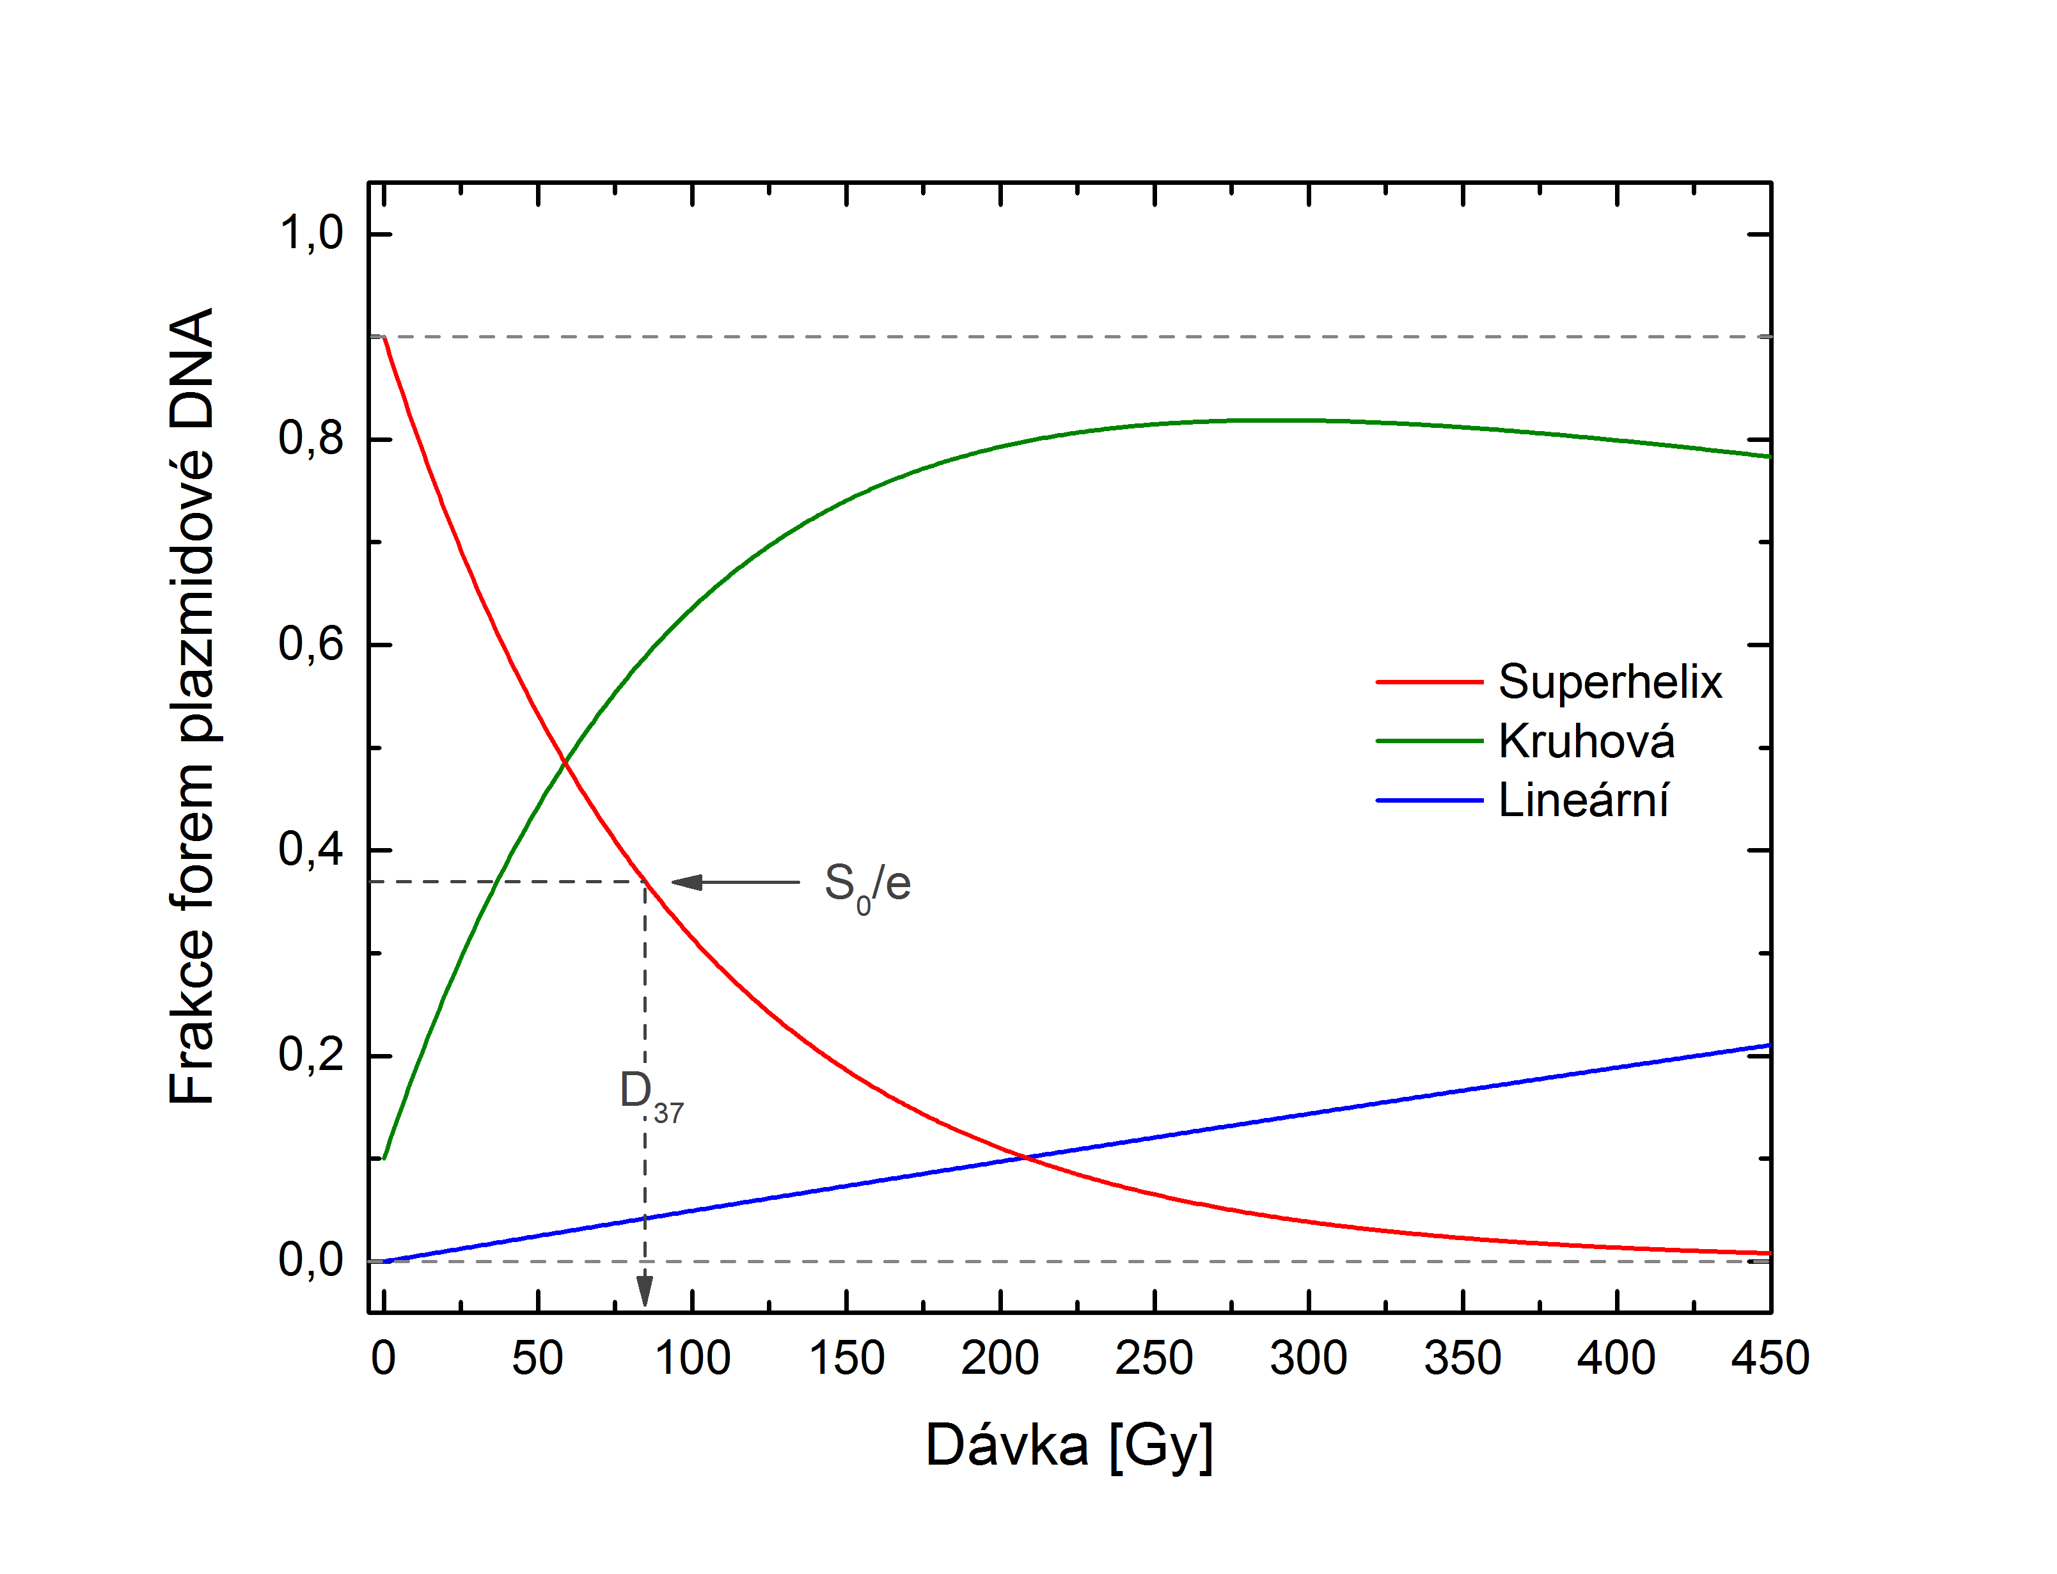
Interaction of XUV/SXR Radiation with DNA
Effects of XUV (46.9 nm) on plasmid DNA demonstrated:
Nováková et al.: Phys. Rev. E 91 (4), 042718, 2015
S
C
L

Slide 28
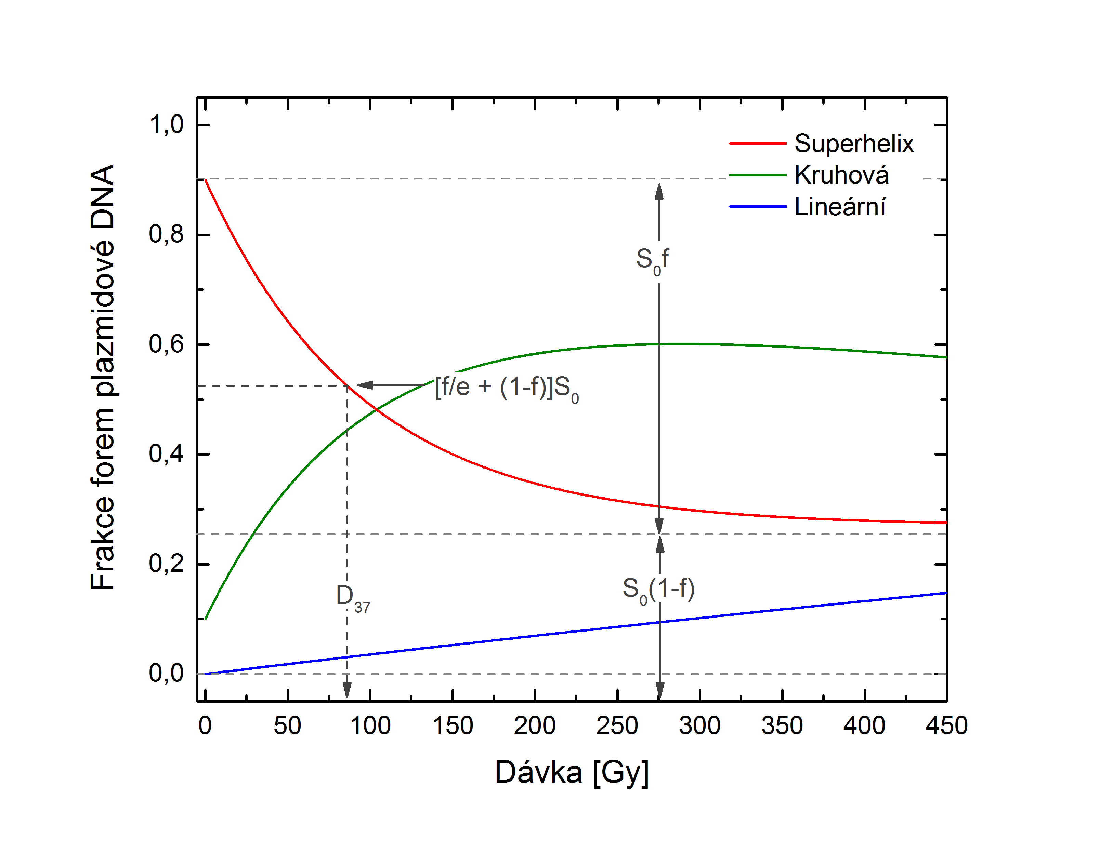
Interaction of XUV/SXR Radiation with DNA
Effects of XUV (46.9 nm) on plasmid DNA demonstrated:
Nováková et al.: Phys. Rev. E 91 (4), 042718, 2015
S
C
L

Slide 29
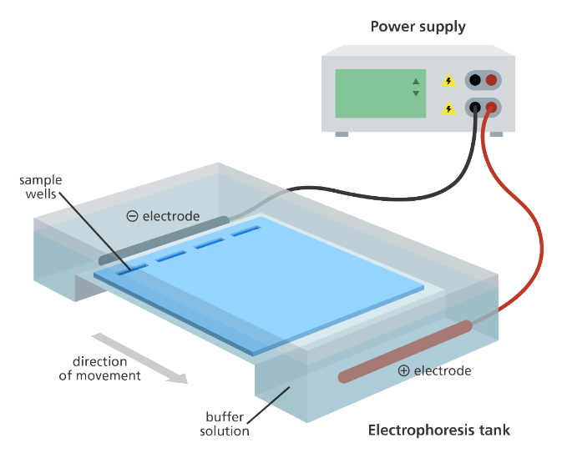
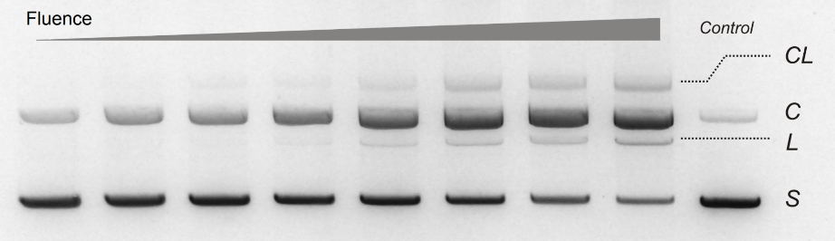
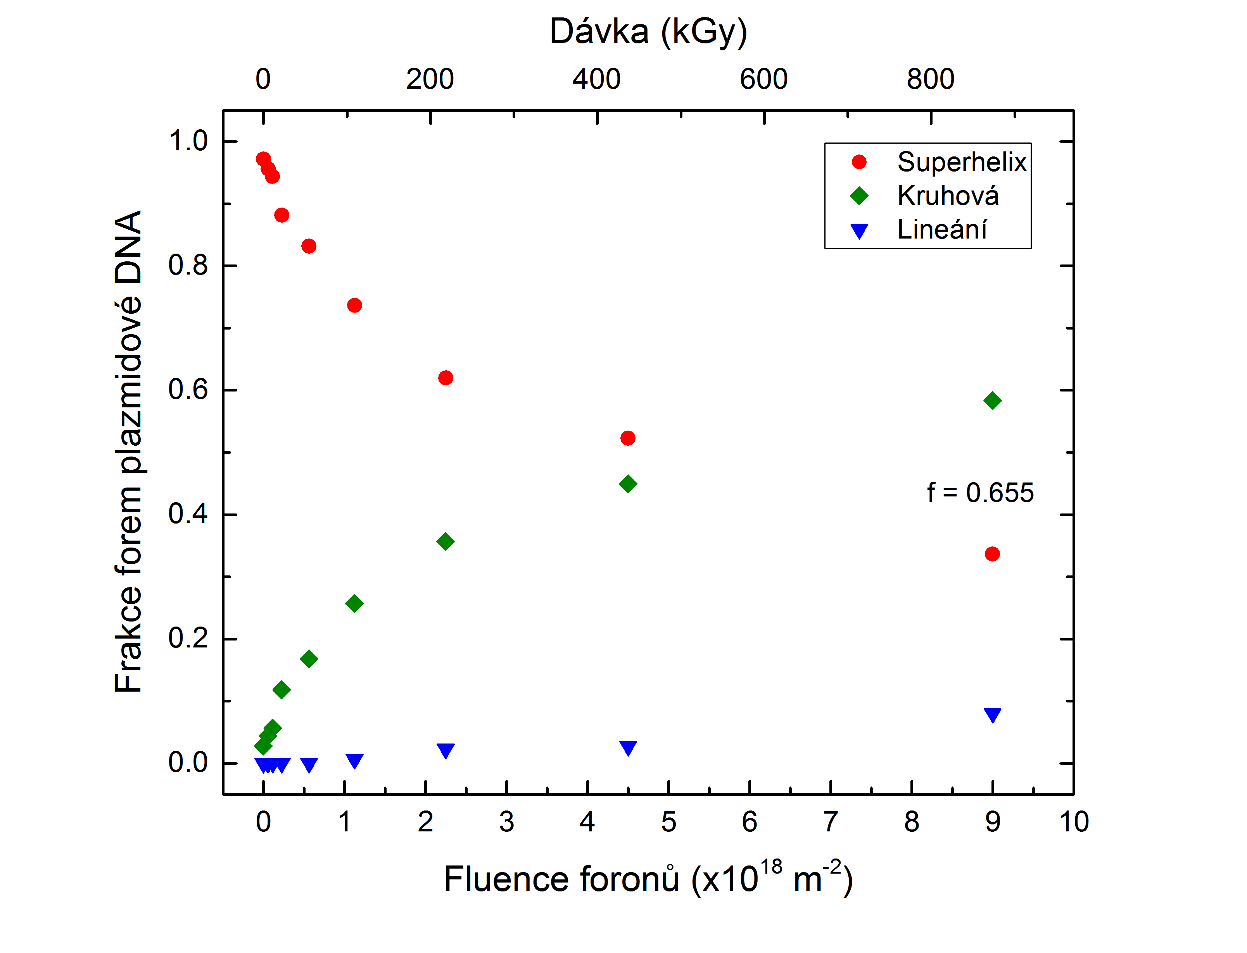
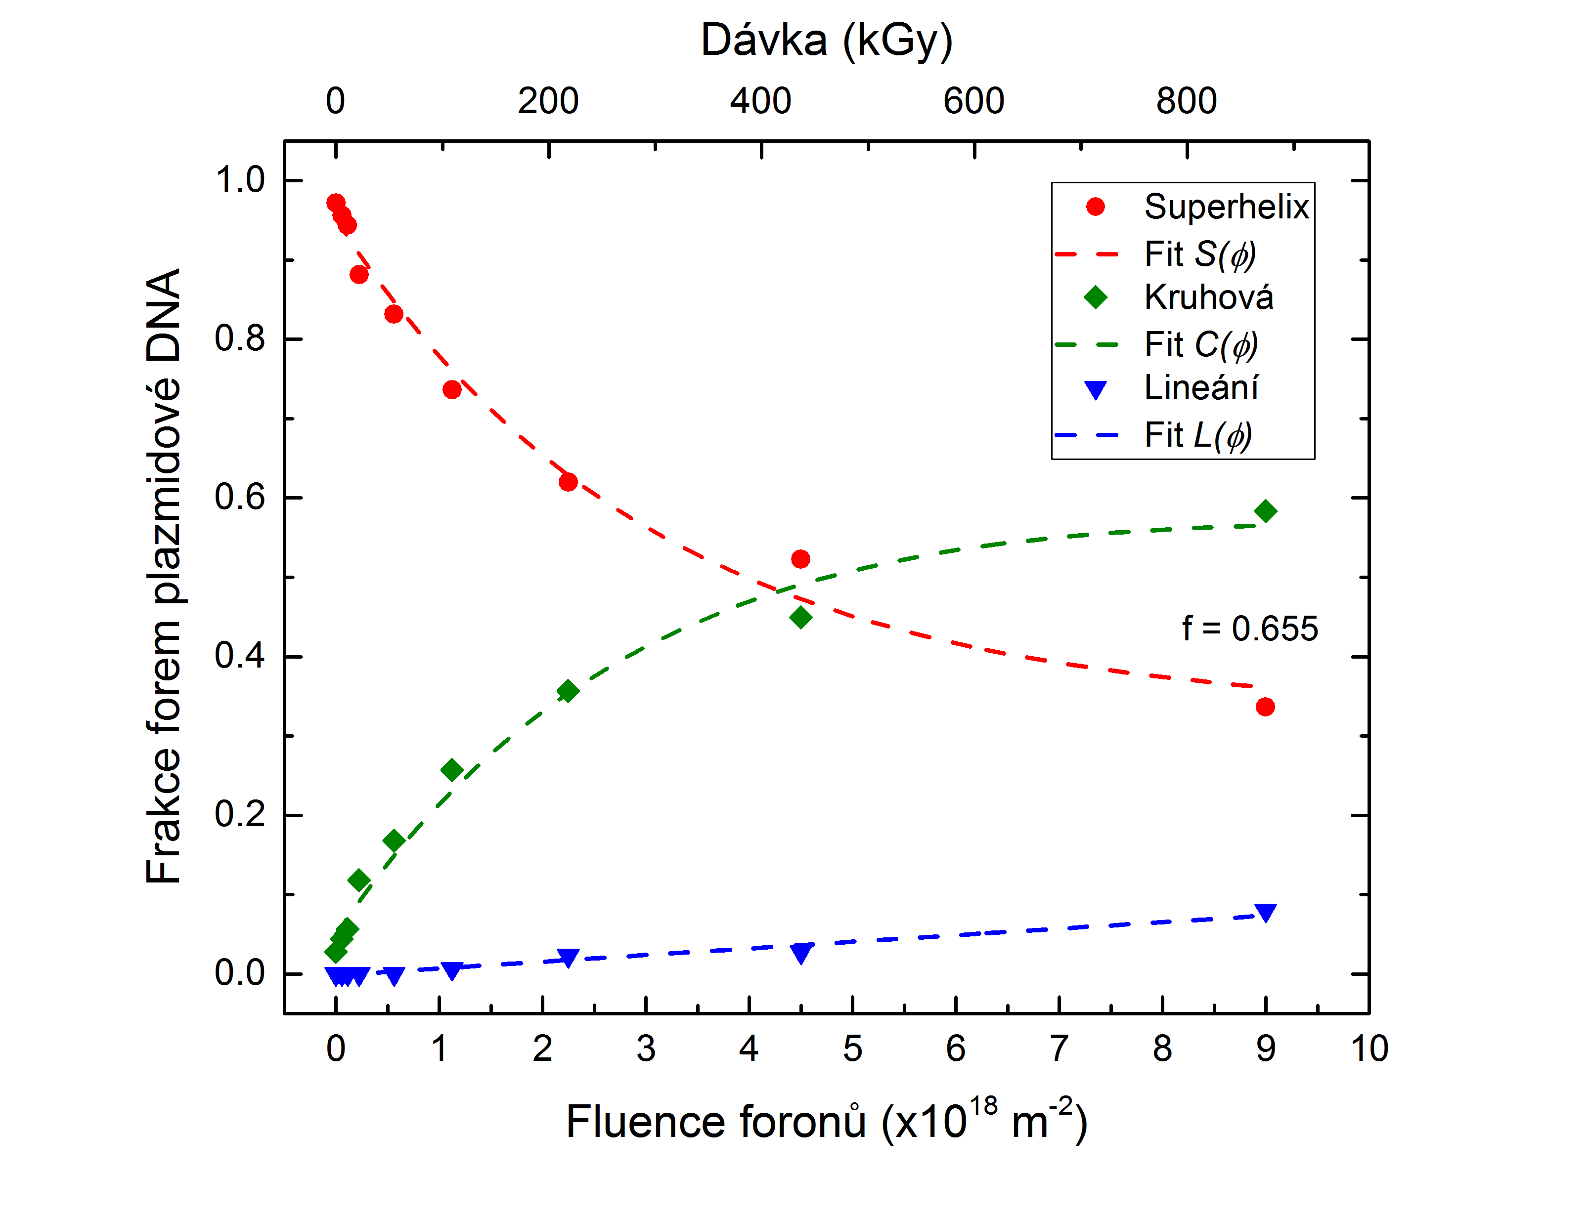
Detection of Plasmid DNA Forms
Agarose electrophoresis + SybrGREEN I
www.yourgenome.org
β_{SSB}
β_{DSB}
f
S₀

Slide 30
Outline
Introduction – motivation
Interaction of XUV and SXR with matter
Interaction of charged particles with matter
Experimental sources of XUV/SXR
Biological samples
Interaction of XUV/SXR with DNA
Dosimetry and Radiation chemical yield
Results
Future plans

Slide 31
Dose and radiation chemical yield
Kerma [Gy]:
Dose [Gy]:
mass energy transfer
coefficient [m²/kg]
energy fluence [J/m²]
surface density [kg/m²]
Radiation chemical yield: Radiation chemical yield G(X) is the ratio of
n(X) and ε, where n(X) is the mean amount of matter of a specified nature
X formed, destroyed or changed by transfer of a mean amount of energy
ε to matter. G(X) = n(X)/ε
_
_
_
[mol/J]

Slide 32
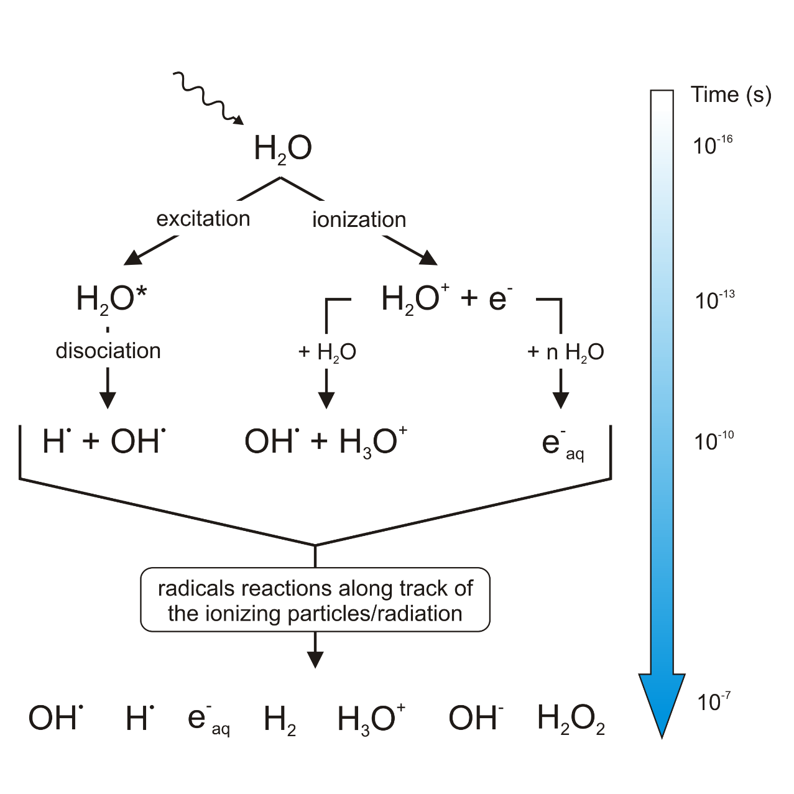
SXR chemical dosimetry
Water radiolysis:

Slide 33

SXR chemical dosimetry
Water radiolysis:
Geant4:DNA simulation
Courtesy of Václav Štěpán, PhD

Slide 34




SXR chemical dosimetry
Established fluorescent dosimetry systems:

Slide 35




SXR chemical dosimetry
Fricke dosimeter:
1 mM FeSO₄, 1 mM NaCl, 0.8 N H₂SO₄
Ionizing radiation interacting with water produces a range of ions, radicals and molecules:
H OH H₂ H₂O₂ H⁺ OH⁻ e⁻_{aq}
$$H+O_{2}→{HO}_{2}$$
ferrous
Fe²⁺
Fe³⁺
ferric
$${Fe}^{2+}+OH→{Fe}^{3+}+{OH}^{−}$$
$${Fe}^{2+}+{HO}_{2}→{Fe}^{3+}+{HO}_{2}^{−}$$
$${HO}_{2}^{−}+H^{+}→H_{2}O_{2}$$
$${Fe}^{2+}+H_{2}O_{2}→{Fe}^{3+}+OH+{OH}^{−}$$
Molecular oxygen is needed and is a limiting factor
The maximum absorbed dose that can be measured is about 400 Gy

Slide 36




SXR chemical dosimetry
?
$$OD=\log_{10}\left(\frac{I_{0}}{I}\right)=c∙ε∙L$$
$$D=\frac{∆OD}{ε∙G({Fe}^{3+})∙ρ∙L}$$
G(Fe³⁺) – Radiation chemical yield (molecules/100 eV)

Slide 37
Outline
Introduction – motivation
Interaction of XUV and SXR with matter
Interaction of charged particles with matter
Experimental sources of XUV/SXR
Biological samples
Interaction of XUV/SXR with DNA
Dosimetry and Radiation chemical yield
Results
Future plans

Slide 38

Results
Action cross sections for pulsed sources (500 ps – 5 ns) in comparison to synchrotron radiation

Slide 39

Results
G values for pulsed sources (500 ps – 5 ns) in comparison to synchrotron radiation

Slide 40
Outline
Introduction – motivation
Interaction of XUV and SXR with matter
Interaction of charged particles with matter
Experimental sources of XUV/SXR
Biological samples
Interaction of XUV/SXR with DNA
Dosimetry and Radiation chemical yield
Results
Future plans

Slide 41
Future plans
Femtosecond XUV/SXR laser (laser-plasma) sources would be beneficial in the study of the dose rate effect
Wider range of XUV photon energies
Apply theoretical modelling approach (fs time scale)
Use of mass spectrometry to determine the fragmented species (damaged bases)
Use of restriction enzymes to distinguish between the damage localized on sugar-phosphate backbone (strand breaks) and nucleobases (abasic sites)

Slide 42




Acknowledgements
Department of radiation and chemical physics IOP CAS
Tomáš Burian
Eva Nováková
Martin Přeček
Libor Juha
Department of personal dosimetry, INP CAS
Marie Davídková
Kateřina P. Brabcová
Václav Štěpán
Department of nuclear chemistry, FNSPE – CTU
Kateřina Tomanová
Martin Vlk
Václav Čuba
Viliam Múčka
Wojskowa Akademia Techniczna
Przemyslaw Wachulak
Andrzej Bartnik
Henryk Fiedorowicz
Daniel Adjei
Mesfin Getachew Ayele
PALS facility
Eduard Krouský
Miroslav Krůs
Thank you for your
attention

