Slide 1
Short-wavelength lithography in semiconductor industry
Dr. Konstantin Tsigutkin, ASML Netherlands B.V.

Slide 2
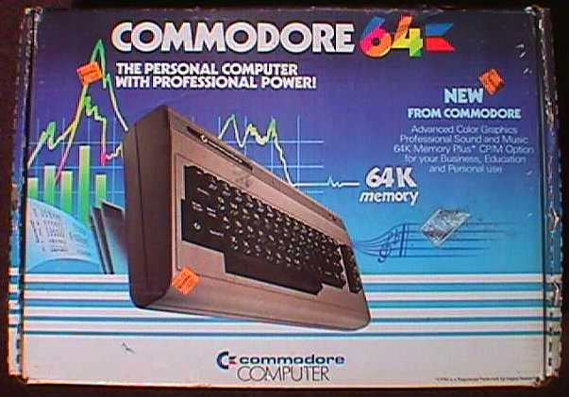
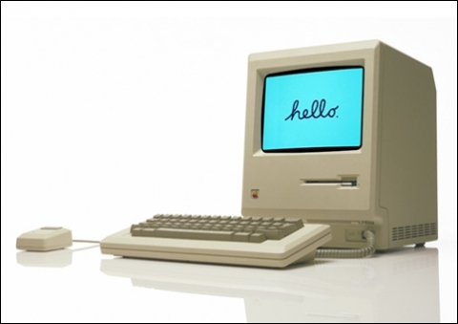
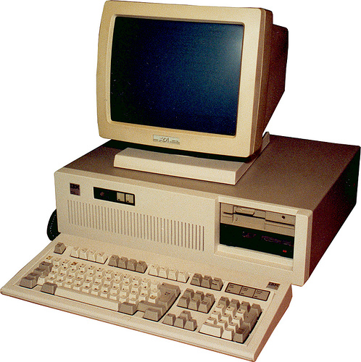
1970s/80s: Geeks buy their first computers

Slide 3

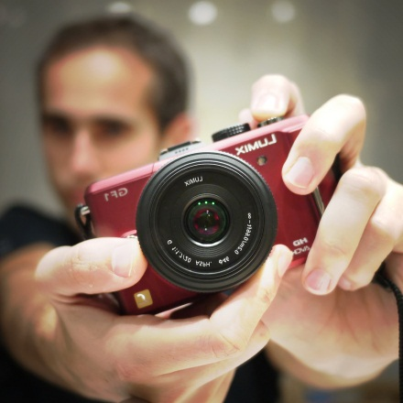
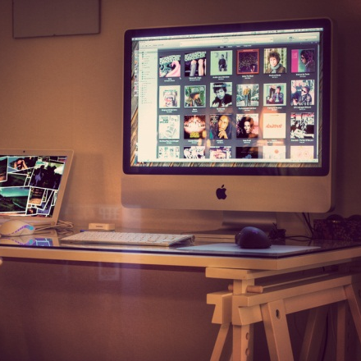
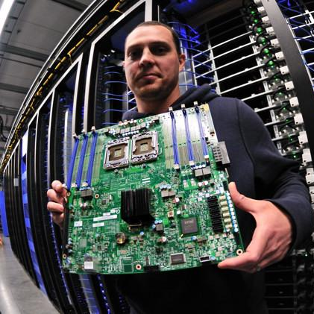
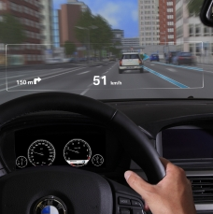
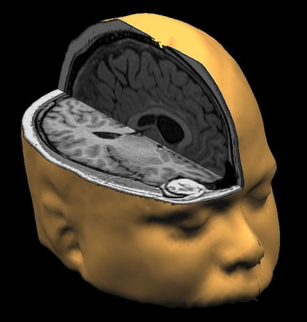
Today, it’s hard to imagine a world without chips
Notes:
It is hard to imagine a world without semiconductor chips.
There would be no computers, for a start. No digital cameras, MP3 players, CDs, DVDs and games consoles. No mobile phones and no Internet. Not even a digital wristwatch.
Semiconductors can also be found in less obvious places. Cars contain dozens of chips: from the micro-controllers that regulate the engine to sensors that detect rain and turn on windshield wipers, a modern car is a computer on wheels.
Medical image scanners, household smoke detectors and even washing machines rely on chips.
There are few inventions that have transformed — and continue to transform — the world as dramatically as the invention of the silicon chip.
ASML makes the machines that are used to manufacture these chips. All of the world’s top chip makers are our customers, so chances are that every day, you use
a device that was partly made on our machines.
Photo credits:
http://www.flickr.com/photos/johanl/3044291684/
http://www.flickr.com/photos/mikelo/4126205344/
http://www.flickr.com/photos/johanl/4365558047/
http://www.flickr.com/photos/intelfreepress/6722296265/
http://www.flickr.com/photos/digitalshotgun/454380458/

Slide 4
More than 180 billion chips are made every year
In 2012, 185 billion chips were produced — 27 for every man, woman and child on the planet.
This equals total sales of $238 billion.
Data: WSTS
Notes:
Note: 2012 data will be available early March

Slide 5
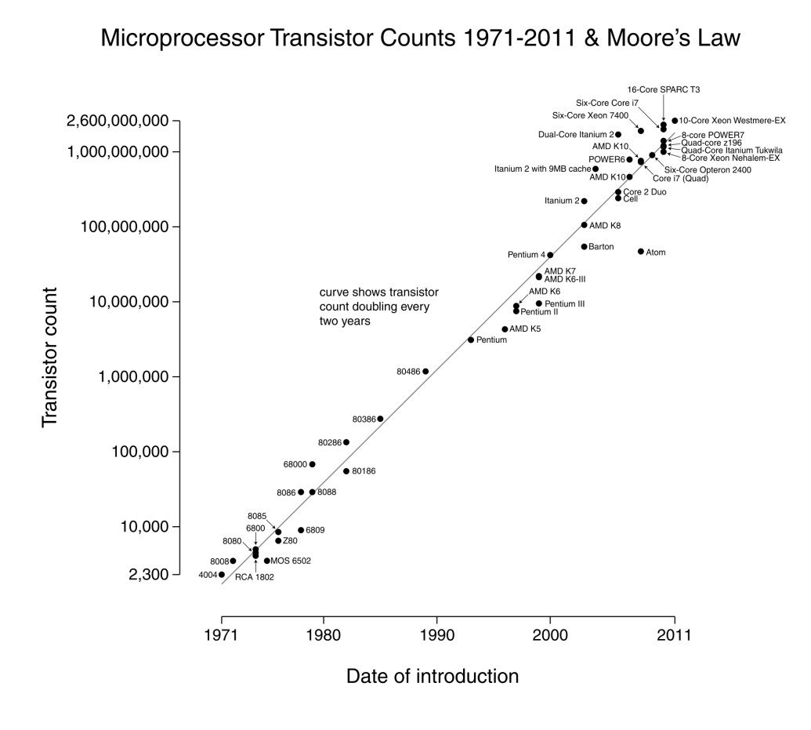
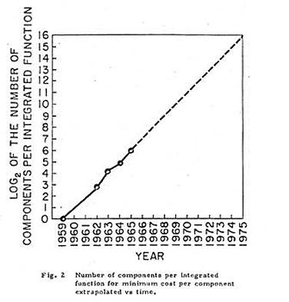

Driving the semiconductor industry: Moore’s Law
Gordon Moore (1965): Number of transistors per chip doubles every year.
Later adjusted to two years, the trend has held for five decades.
Source: Intel Museum
Notes:
But before we go into details, let’s take a step back, and look at the big overarching trend that has driven the semiconductor industry for the past decades.
In 1965, Gordon Moore, who later went on to be one of the co-founders of Intel, observed that the number of chips that could be inexpensively placed on a chip doubled every year as manufacturing technology advanced. He believed that trend would continue.
He later adjusted the period to two years, but the trend has held steady since.
Intel’s 4004 processor, launched in 1971, had 2,300 transistors. Today’s chips have more than a billion.
But chips have not gotten (much) larger. The transistors have gotten smaller.

Slide 6
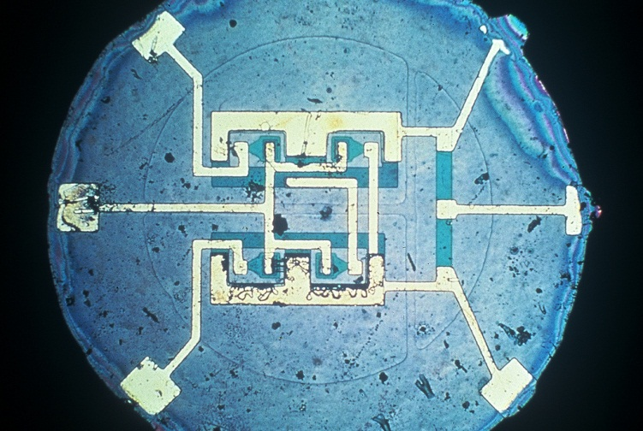
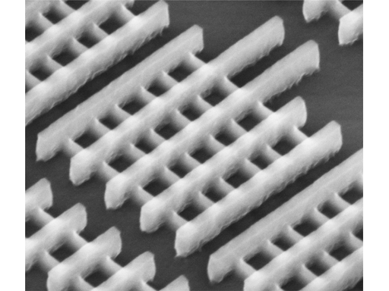
Key to Moore’s Law: Making smaller transistors
Transistor length has shrunk by a million
The first integrated circuit on silicon, on a wafer the size of a fingernail
(Fairchild Semiconductor, 1959)
Today: More than a billion transistors on the same area
(Intel, 2012)
Notes:
Chips have not gotten (much) larger. The transistors have gotten smaller. Much smaller.
The first integrated circuit on silicon, the forefather of current chips, was made on a wafer the size of a fingernail.
With today’s manufacturing technology, we can fit more than a billion transistors onto the same area.

Slide 7
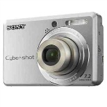


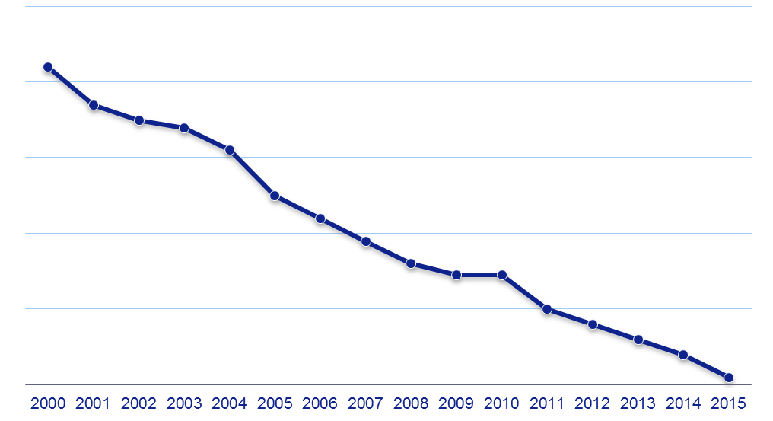
Moore’s Law makes chips cheaper…
10000
$1,162 for 1 GB
1000
100
Smartphones
Lithography cost per unit of memory $/GByte
Solid state
hard drives
10
$0.17 for 1 GB
1
Source: Gartner. High quality Flash
Notes:
7
7

Slide 8
… and more energy-efficient
Computations per Kilowatt hour double every 1.5 years
1.E+16
2008 + 2009 laptops
1.E+15
SiCortex SC5832
Dell Dimension 2400
1.E+14
Gateway P3. 733 MHz
1.E+13
Dell Optiplex GXI
1.E+12
IBM PS/2E + Sun SS1000
486/25 and 486/33 Desktops
1.E+11
1.E+10
IBM PC
IBM PC-AT
Cray 1 supercomputer
IBM PC-XT
1.E+09
DEC PDP-11/20
Computations per kWh
1.E+08
SDS 920
1.E+07
Commodore 64
1.E+06
Univac III (transistors)
1.E+05
1.E+04
Univac I
Univac II
Regression results:
N = 76
Adjusted R-squared = 0.983
Comps/kWh = exp(0.440243 x year – 849.259)
Average doubling time (1946 to 2009) = 1.57 years
1.E+03
1.E+02
Eniac
EDVAC
1.E+01
1.E+00
1940
1950
1960
1970
1980
1990
2000
2010
Source: Jonathan Koomey, Lawrence Berkeley National Laboratory and Stanford University, 2009
Notes:
8

Slide 9
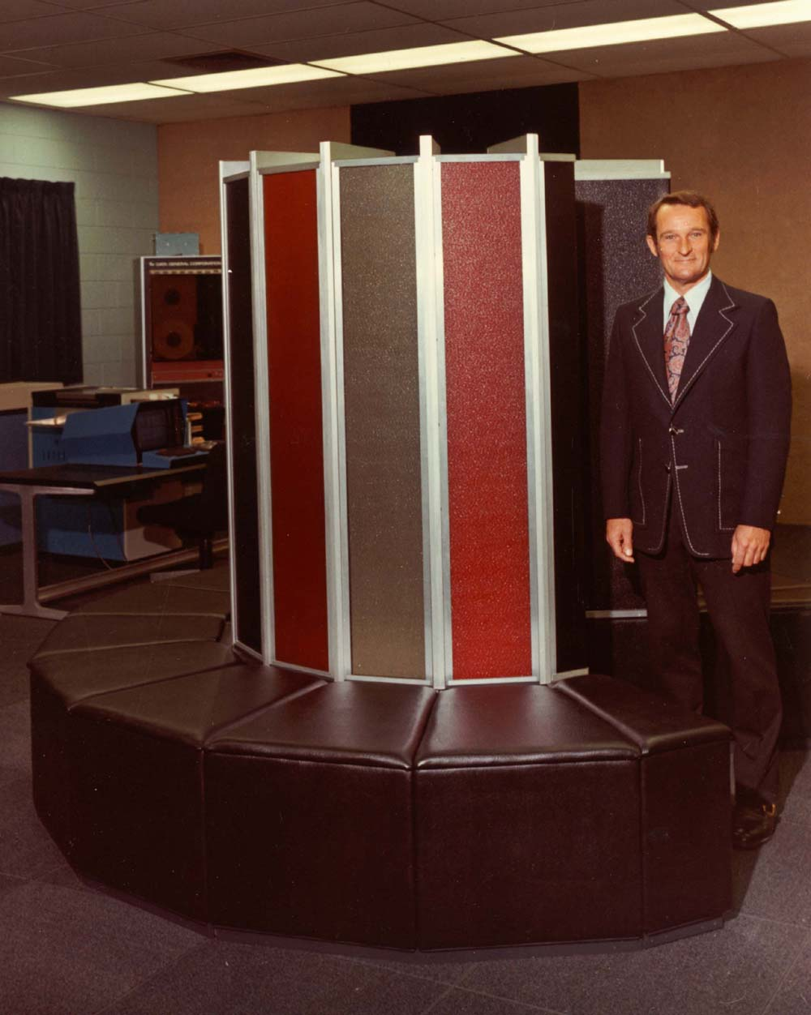
Moore’s Law means doing more with less
Cray 1: The first supercomputer
  8 megabytes of memory
  Weight of an elephant (5.5 tons)
  150 kilowatt power supply (enough for 50 households)
  Freon cooling system
  $8.8 million ($30 million in today’s dollars)
1976
Notes:
9
The year is 1976. At Los Alamos National Laboratories in the United States, the first “supercomputer” is installed. The Cray-1 weighs in at 5-1/2 tons, it comes with 8 megabytes of memory, a 150 kilowatt power supply and an “innovative Freon cooling system”. It set you back almost 9 million dollars – or 30 million dollars today adjusted for inflation. Today… (next slide)

Slide 10

Moore’s Law means doing more with less
The supercomputer in your pocket:
a fraction of the
materials,
price,
power consumption
1976
2013
Notes:
10
…today we carry that sort of computing power in our pockets. The mobile phone is a supercomputer in your pocket: it completely wipes the floor with the Cray-1 in terms of performance (512 MB of memory – plus gigabytes and gigabytes of flash storage) and it does so at a fraction of the weight, materials, price, and power consumption. The processor in there probably doesn’t use much more than 1 Watt. It doesn’t require an industrial-strength cooling system, and it costs much less than $30 million.
This is what shrink means: doing more with less.
ASML has made a major contribution to shrink: our machines allow chip makers to pattern finer features, to shrink transistors, and to make chips more powerful and more energy-efficient at the same time.

Slide 11
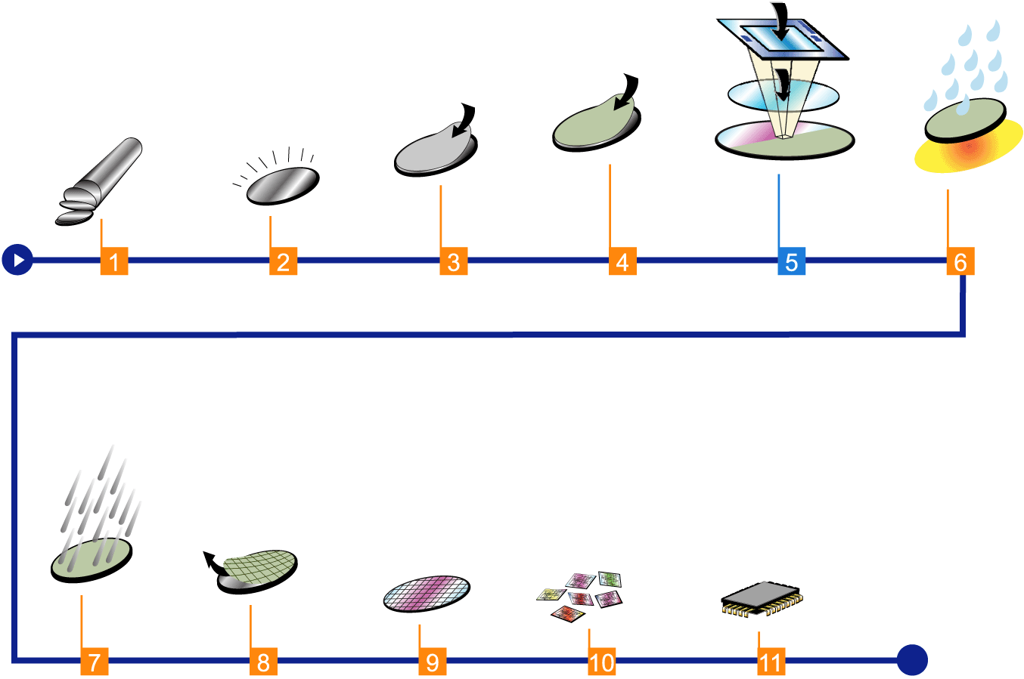
How semiconductors are made
Exposure
Photo-lithography
Developing
and baking
Photoresist
coating
Material deposition
or modification
Slicing
Mono-crystaline
silicon “boule”
(300 mm diameter
x ~1 m length)
Polishing
Blank wafer
Repeat for each layer
(chip is 3D structure
with 20-30 layers)
Etching
Removing
the photoresist
(ashing)
Separation
(dicing)
Completed
wafer
Packaging
Testing
Chips
Module

Slide 12
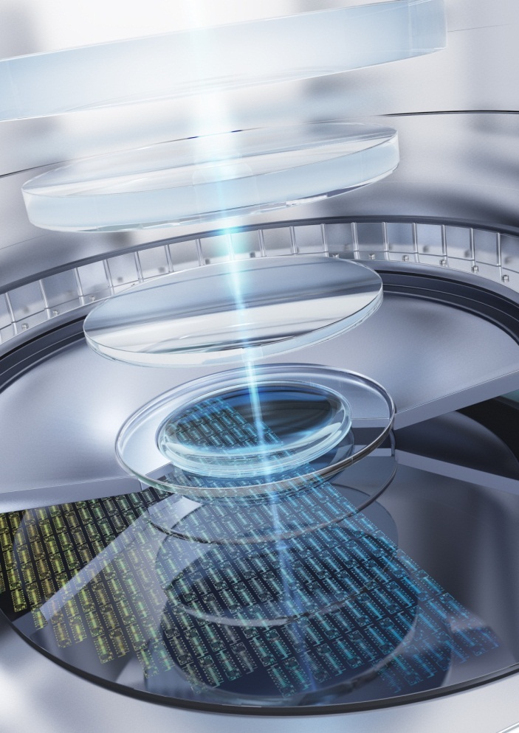
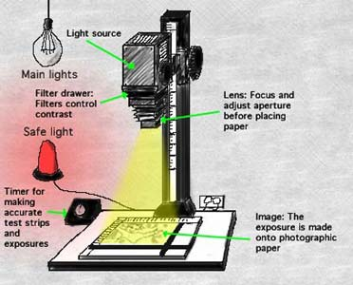
Lithography is critical for shrinking transistors
Like a photo enlarger of old, lithography forms the image of chip patterns on a wafer
Notes:
The critical technology for shrinking transistors is lithography.
What is lithography? If you’re old enough to remember how photos were printed on photo paper, you know how a lithography machine works.
We have a negative – we call it the mask, or the reticle – which contains the blueprint of the chip pattern.
Using intense laser light, this pattern is projected onto the wafer.
The wafer has earlier been coated with a light-sensitive substance, the photoresist.
When the unexposed parts are etched away, the pattern that we have projected is revealed.
In other words, lithography is the production step that creates the billions of transistors on a chip – their shape, their position, and the wires that connect them and create a working chip.

Slide 13
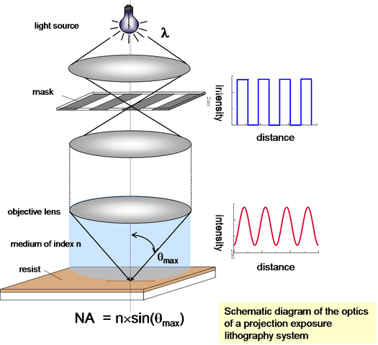
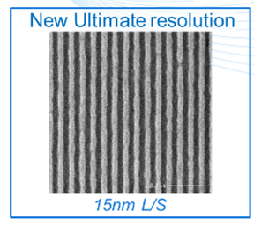
The principle of Lithography
Rayleigh equation:
Notes:
Lithography is the most critical part of the process to create these structures, whereby a pattern is imaged into the photoresist on the surface of a silicon wafer.
The smaller the feature size the higher the performance. Therefore there is a continuous demand to shrink the feature size.

Slide 14
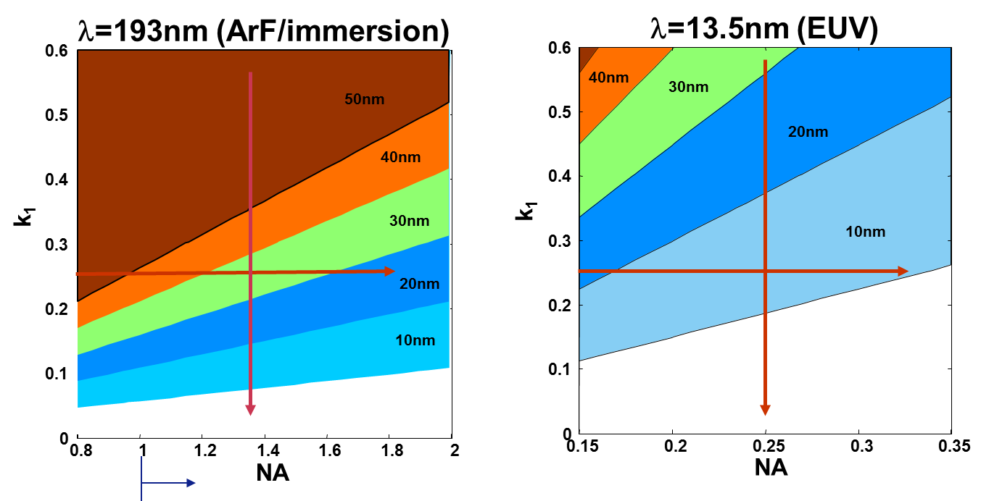
Rayleigh formula relations
CD = critical dimension/resolution (usually half-pitch of grating)
= wavelength (Hg i-line 365nm, KrF 248nm, ArF 193nm, EUV 13.5nm)
NA = numerical aperture of optics (immersion: NA > 1, “hyper-NA”)
k₁ = factor for litho process “complexity”/”capability” (illumination settings,
reticle, resist), minimum for single exposure = 0.25

Slide 15
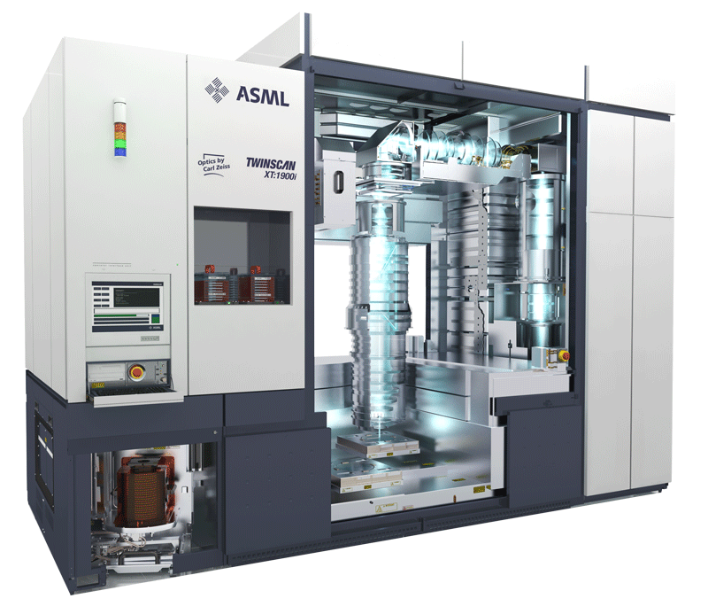
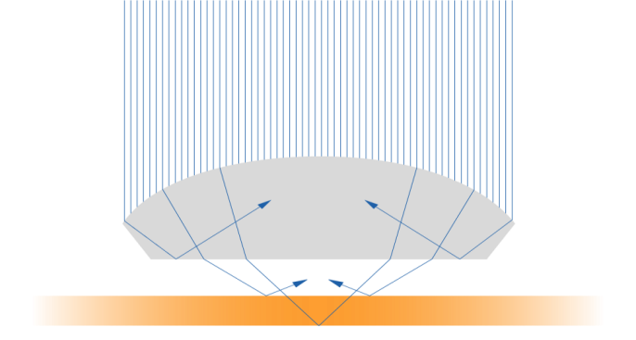
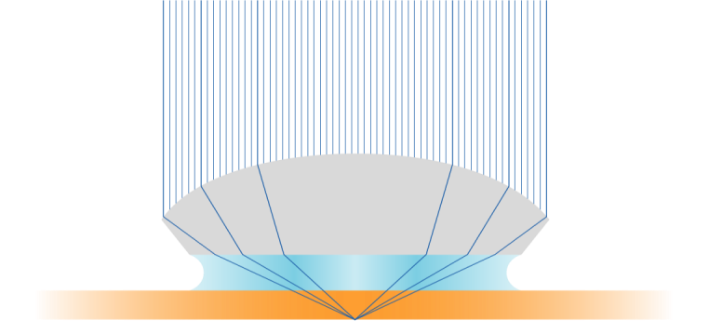
Immersion Lithography: High Numerical Aperture (NA)
Water improves resolution and depth of focus
Lens
Air
Lens
38 nm features can be imaged with immersion scanners
Water
Notes:
Immersion lithography uses a liquid between the wafer and the lens to increase the depth-of-focus and resolution of the projected image (by increasing the numerical aperture (NA) of the lens). The primary advantage of immersion lithography is that it enables 193 nm wavelength scanners to image 38 nm features (and possibly below) in a single exposure.

Slide 16
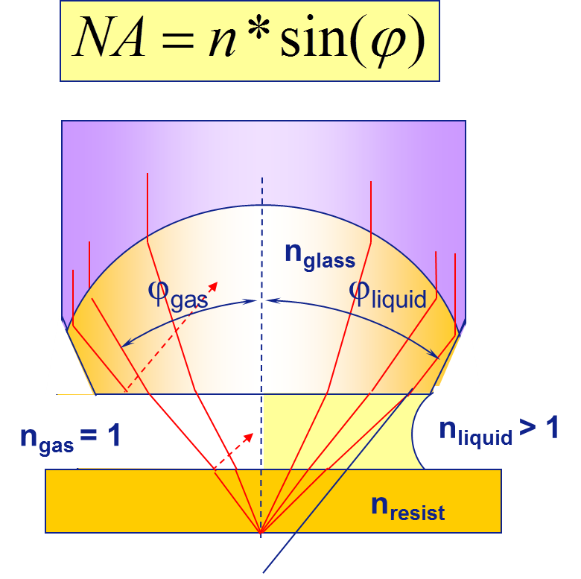
Optical advantage of immersion - Resolution
Replace the air between the projection lens and the wafer by a fluid (e.g. water) to increase the Numerical Aperture (NA)

Slide 17
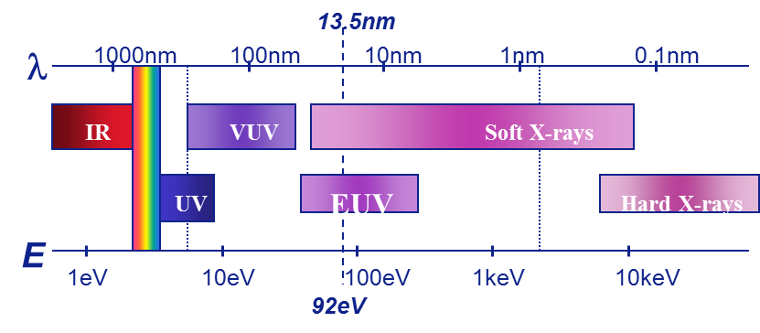
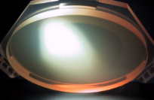
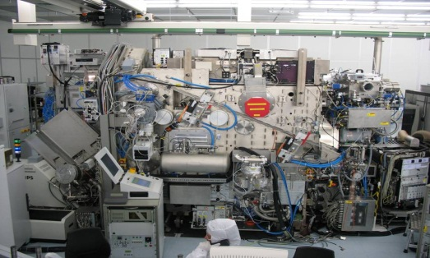
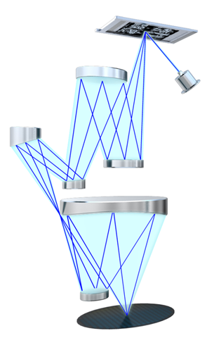
Extreme Ultra Violet Lithography has 3 unique features
EUV = 13.5 nm radiation
Generated with a plasma source
It requires atomic flat multilayer coated aspheric mirrors
Measured shape accuracy: 45 pico meter
=> much less than the diameter of Si atom
And all in vacuum system
and reflective masks
C_{x}H_{y} = 1x10⁻⁹ mbar
H₂O = 1x10⁻⁷ mbar
Design example
Notes:
Will talk to difference from what Pete presented.

Slide 18
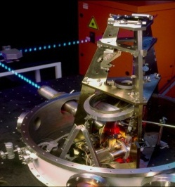
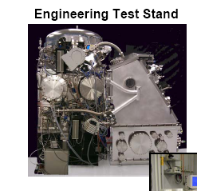
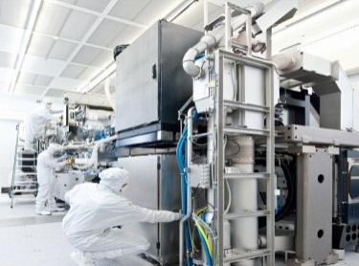
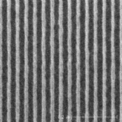
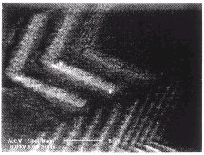
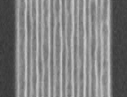
EUV has >35 years of history
First publications on EUV (LLNL, Bell Labs, Japan)
ASML starts EUVL research program
ASML ships
2 alpha tools: IMEC (Belgium) en CNSE (US)
ASML ships first pre-production tool (Korea)
’84
’85
’86
’87
’88
’89
’90
’91
’92
’93
’94
’95
’96
’97
’98
’99
’00
’01
’02
’03
’04
’05
’06
’07
’08
’09
’10
’11
’12
NL:
Japan:
USA:
NL:
NL:
160
nm
70nm
L&S
40 nm hp
5 μm
40 nm hp
80
nm
40 nm hp
28 nm
Lines and spaces
19 nm
Lines and spaces
Notes:
18

Slide 19
Sources of soft X-ray radiation
Synchrotron radiation
Free Electron Lasers
X-ray tubes (e.g. Si L-edge at 100 eV)
High Harmonic Generation of fs-laser pulses
Plasma radiation sources
Plasma parameters
Source requirements for projection systems:
High EUV radiation power (average >100W) → High repetition rates for pulsed systems (>10 kHz)
High conversion efficiency (input energy → EUV)
Small emitting volume (< 1mm)
Long lifetime (1 year of continuous operation and longer)
Lab-size footprint
Reasonable cost of the equipment and operation

Slide 21
EUV spectrum of Xenon plasmas
n_{e}=10¹⁷-10¹⁹ cm⁻³
T_{e}=10-30 eV

Slide 22
Winner:
Tin!

Slide 23
Laser-Produced Plasma vs Discharge-Produced Plasma
Laser produced plasma
Discharge produced plasma
T_{e} ~ 10 – 500 eV
n_{e} ~ 10¹⁷ – 10²¹ cm⁻³
P
Lens
laser
EUV
Plasma
Target
Parameter |  | LPP | DPP
Pulse duration | ns | 0.2 – 10 | 10 – 100
Energy | J/Puls | 0.25 – 1.5 | 2 – 10
Diameter | μm | 50 – 100 | 100 – 500
Typical parameters for laser and discharge produced plasmas

Slide 24
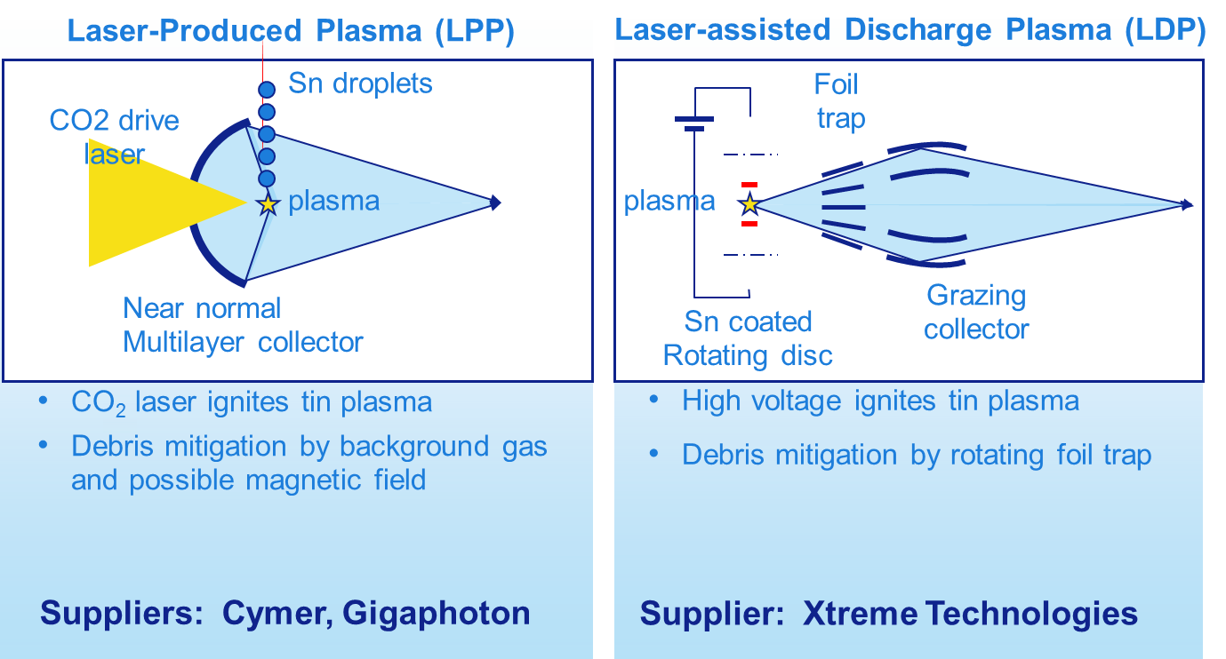
Two EUV Sn-source concepts are in use

Slide 25
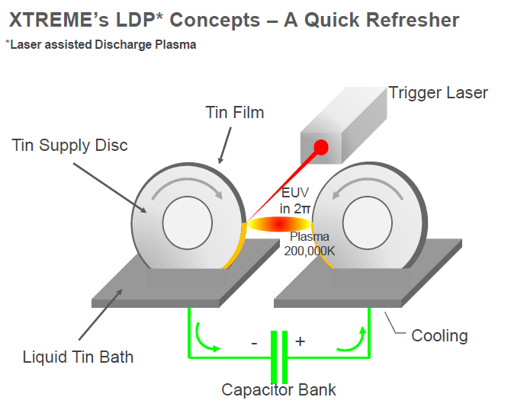
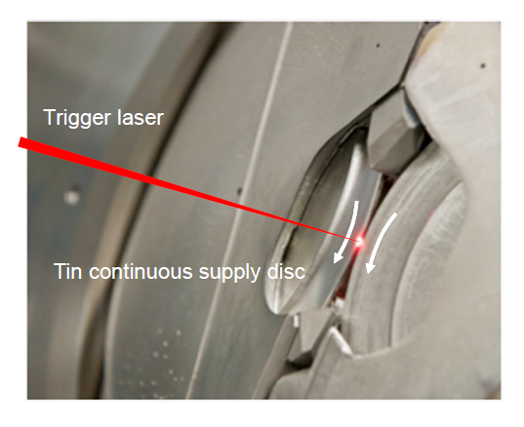
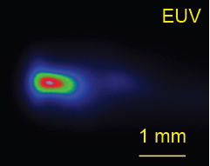
LDP concept – Tin flow on fast rotating wheels
Very interesting thin film dynamics under the action of high centrifugal forces
Laser pulse to generate a cloud of Sn
Electrical spark for conversion into in-band EUV
Liquid metal for low resistive contact between plasma and capacitor bank
Regenerating liquid tin surface to avoid electrode erosion
Efficient heat removal by liquid metal cooling

Slide 26
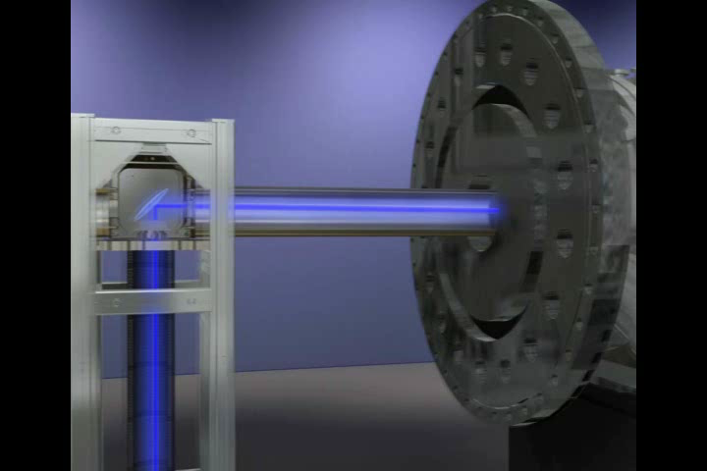
LPP source movie

Slide 27
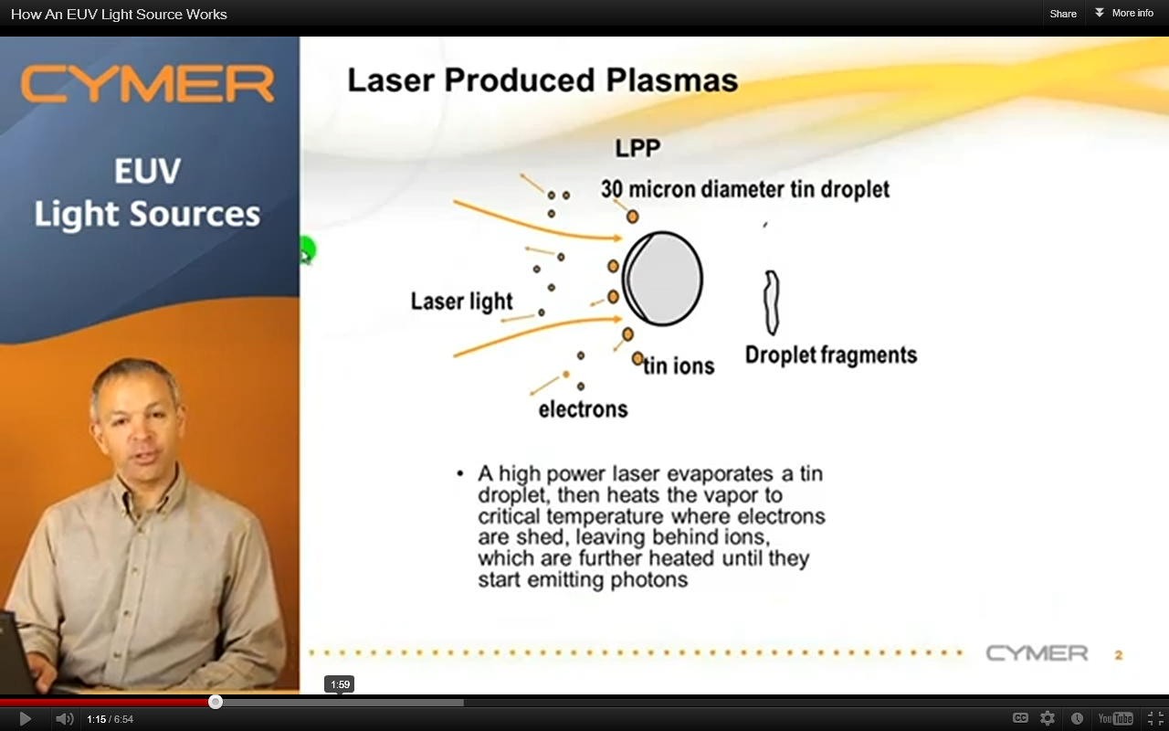
LPP Plasma generation principle

Slide 28
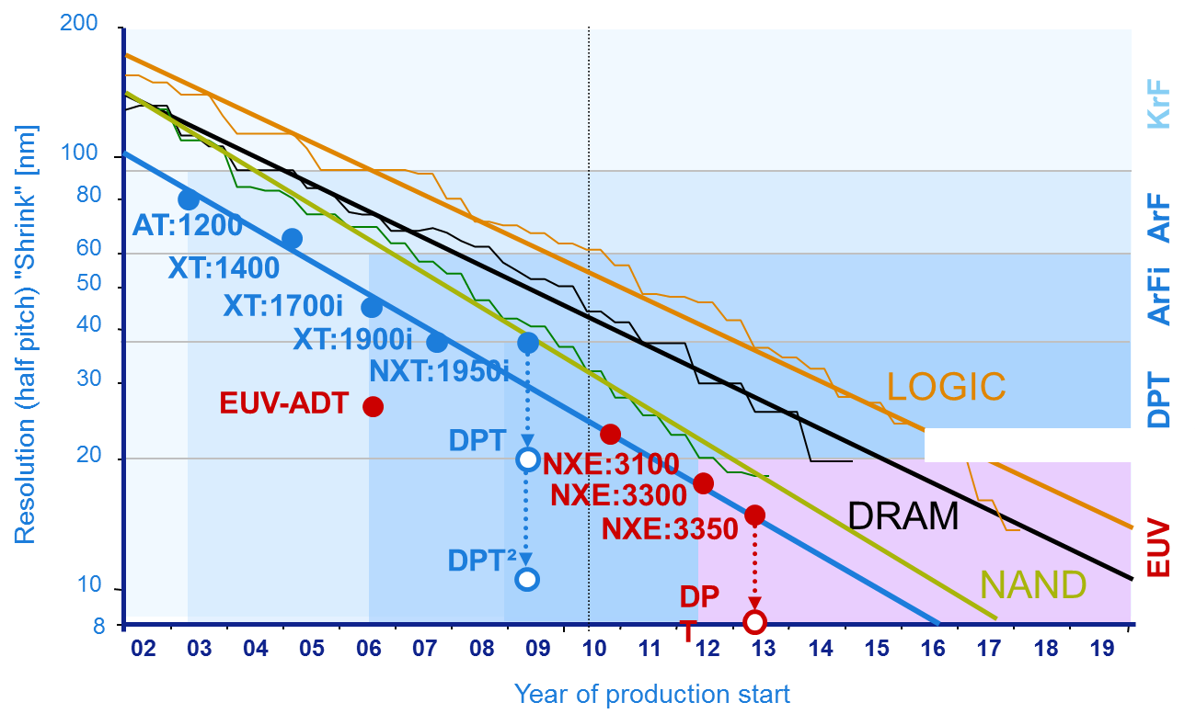
Chip shrink will continue
Notes:
28

Slide 29
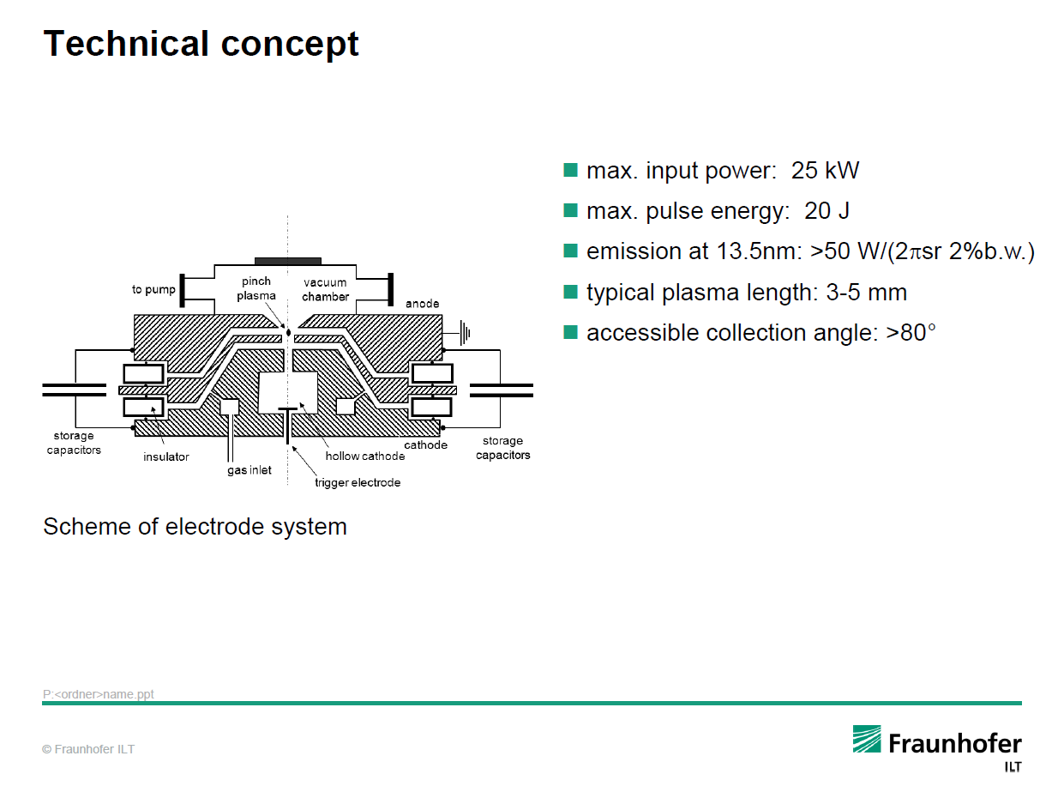
Gas Discharge EUV sources for metrology applications

Slide 30
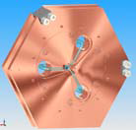
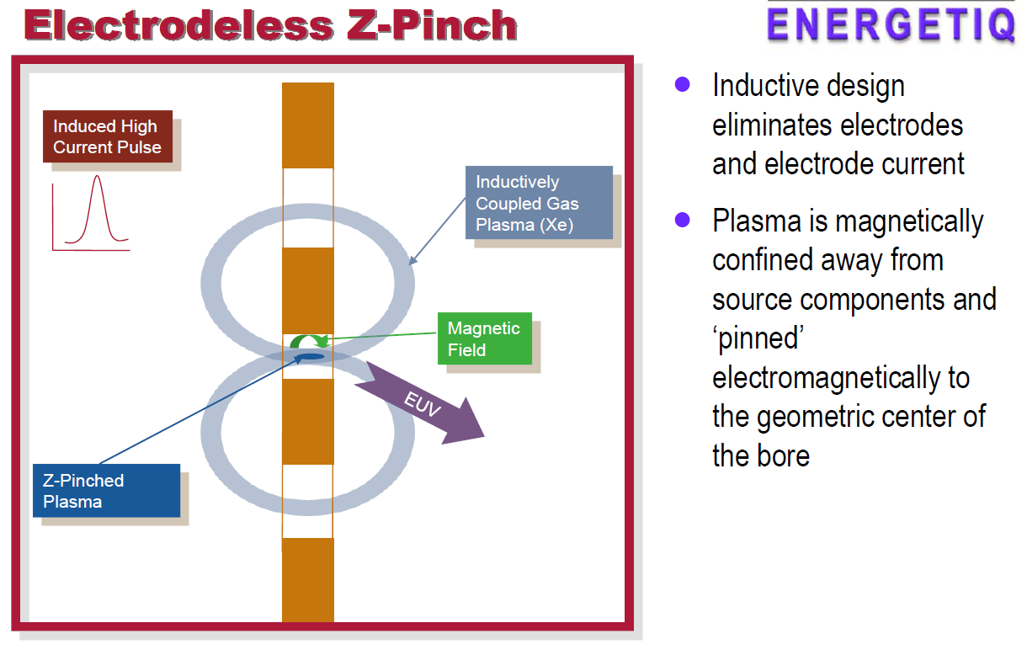
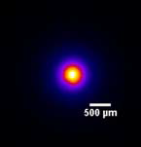
Gas Discharge EUV sources for metrology applications

Slide 31
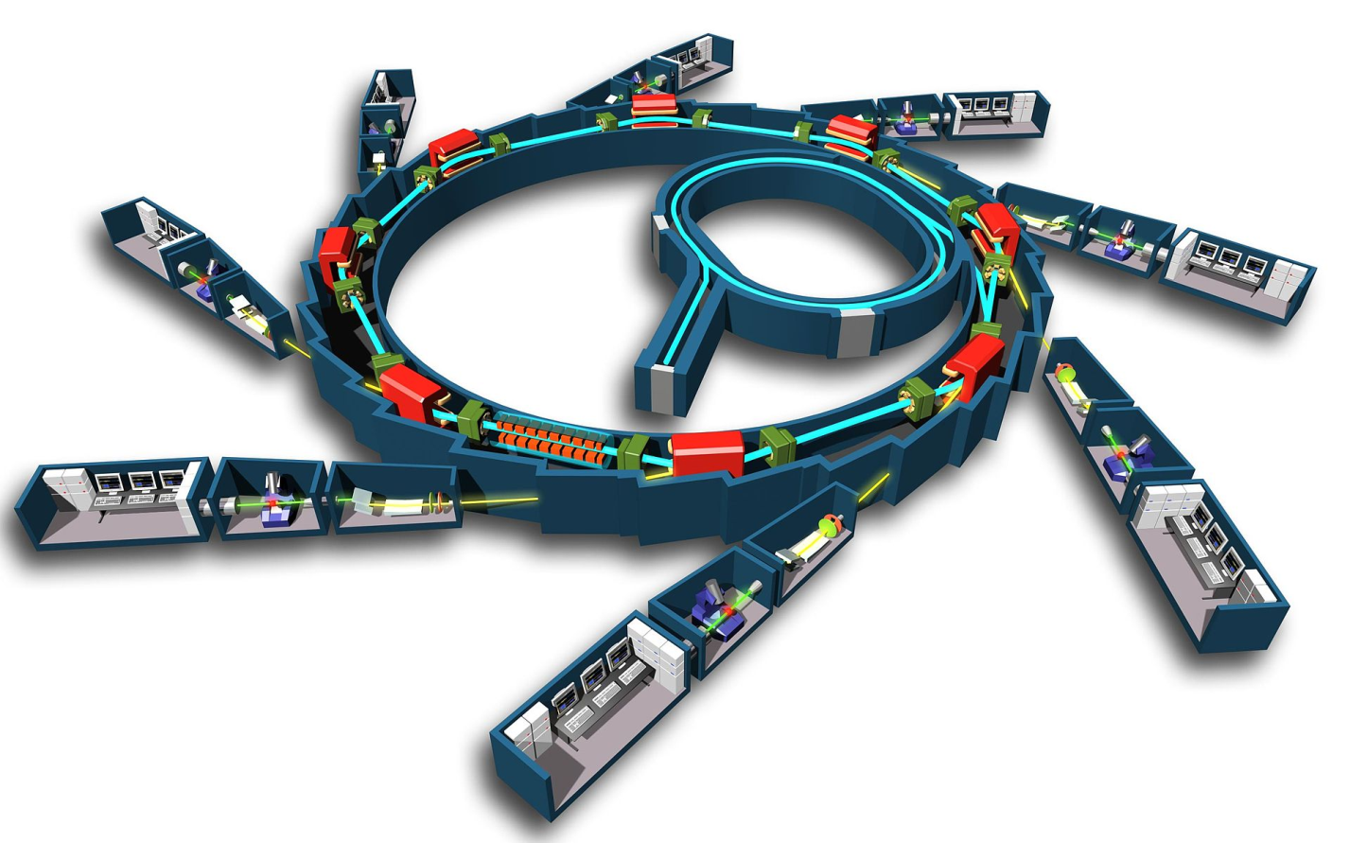
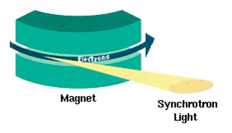
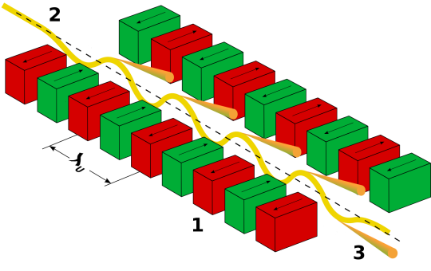
Synchrotrons

Slide 32
HHG fs-lasers
© Center for EUV Lithography, LASTI, University of Hyogo

Slide 33
Nanotechnology
EUV
EUV

