Slide 1
Time resolved VUV LIBS - Limit of Detection (LOD) Optimization for Light Elements in Metals
Syedah Sadaf Zehra
DCU and UNIPD
Supervisors
Dr. Paddy Hayden, Prof. John Costello, and Prof. Piergirogio Nicolosi
EXTATIC Welcome Week – Prague 2017

Slide 2
Outline
Introduction
  Research Aim
  Research Objectives
LOD Optimization
  Results & Discussion
  Conclusion
Depth Profiling Using LIBS
  Introduction
  Experimental Setup
  Results and Discussion
Conclusion
Future Work

Slide 3
Introduction
Laser Induced Breakdown Spectroscopy (LIBS)?
- Analytical method to detect elemental composition of solid, liquid, and gases (qualitatively and quantitatively).
Laser focused on to target to form plasma
Spectral line intensities determine elemental composition

Slide 4
Research Aims
Optimisation of Limit of Detection (LoD) for Time Resolved VUV LIBS
Characterisation of metals (such as depth profiling) using VUV LIBS system.
Dual pulse Optimized LOD obtained for Carbon is 3.6 ppm±0.3 ppm and Sulphur 1.5±0.1 ppm using time integrated system previously in DCU*.
*X. Jiang, P. Hayden et al., Spectro. Acta B 86, 66 (2013)

Slide 5
Research Objectives
Exploration of Time Resolved VUV LIBS for LOD Optimization
Time Resolved vs
Time Integrated LIBS Comparison
LIBS Application in Depth Profiling of thin Metallic films

Slide 6
Research Road Map
Year 3
Year 2
Final Experiments
Year 1
LIBS Application
LOD Optimization
(Initial Experiments)
TR LIBS Dual Pulse
Time Integrated
Depth Profiling
Depth Profiling
Time Resolved
Time Integrated
LOD Optimization
Time Resolved
Time Resolved Vs Time Integrated
LIBS Application in depth profiling
Dual Pulse Time Resolved LIBS
Time Resolved System shows better Signal to Noise ratio
Crater size and ablation rate of thin metallic films was calculated .
Dual Pulse time resolved LIBS for limit of detection optimization.

Slide 7
Outline
Introduction
  Research Aim
  Research Objectives
LOD Optimisation
  Results and Discussion
  Conclusion
Depth Profiling Using LIBS
  Introduction
  Experimental Setup
  Results and Discussion
Conclusion
Future Work

Slide 8
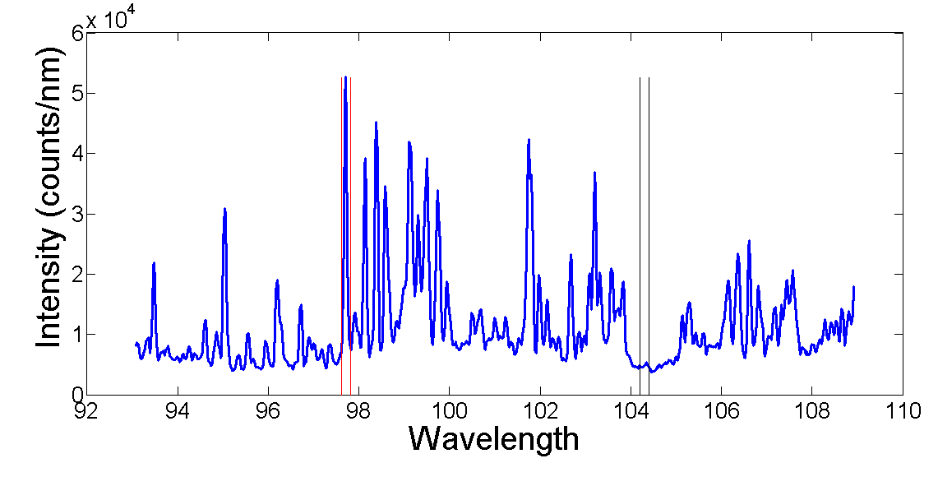
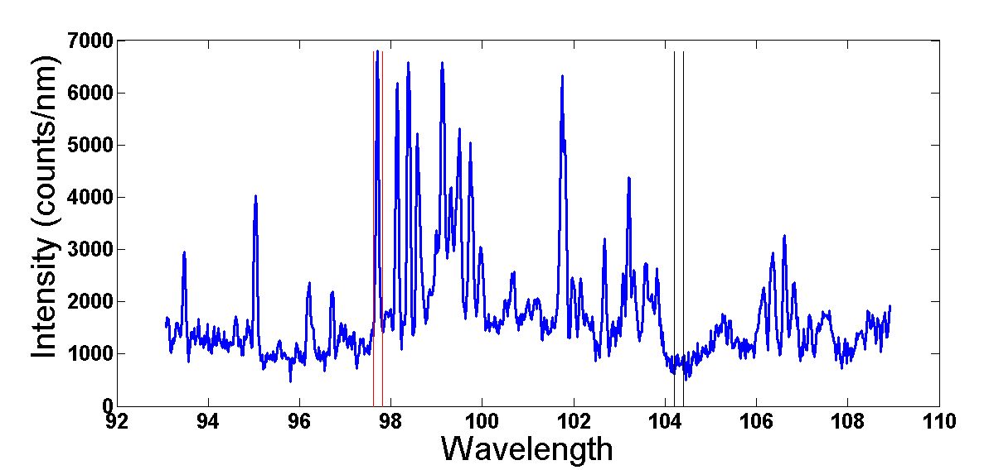
Results
Time integrated plasma emission spectrum
Target at 2 mm distance from the spectrometer optical axis
11 pixels integrated around the C III 1s²2s2p to 1s²2s² line at 97.7 nm
Also background taken as 11 pixels around 104 nm
Target at 4 mm distance from the spectrometer optical axis
11 pixels integrated around the C III 1s²2s2p to 1s²2s² line at 97.7 nm
Also background taken as 11 pixels around 104 nm

Slide 9
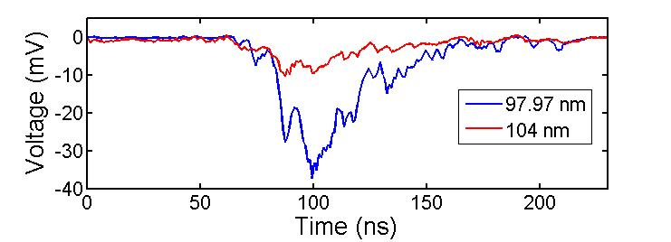
Results
Time resolved plasma emission results at 2 mm
Exit slit width was set to 282 µm to have same spectral windows as time integrated analysis
Window of 90 ns to 230 ns chosen

Slide 10
Discussion
Comparison of analytical quality of three methods for carbon in steel
Method | R- value | LOD | Signal / Background
Time integrated VUV LIBS at 2 mm | 0.98837 | 224ppm | 2.4
Time integrated VUV LIBS at 4 mm | 0.99988 | 316ppm | 2.8
Time resolved VUV LIBS at 2 mm | 0.99985 | 56ppm | 3.3

Slide 11
Conclusion
Time resolved method shows higher signal to background ratio and lower limit of detection for carbon concentration in steel samples.
Provides increase in calibration curve quality.

Slide 12
Outline
Introduction
  Research Aim
  Research Objectives
LOD Optimisation
  Introduction
  Experimental Setup
  Results and Discussion
Depth Profiling Using LIBS
    Introduction
    Experimental Setup
    Results and Discussion
Conclusion
Future Work

Slide 13
Introduction
Depth Profiling is a process where the element or chemical content of a sample is measured as a function of depth.

Slide 14
Depth Profiling Techniques
Technique | Application | Advantages | Disadvantages
Secondary ion mass spectroscopy (SIMS) | Solar cells Analysis, Electronic parts Analysis, etc. | Good depth resolution around 50 A | Not flexible to other wavelengths
Auger electron Spectroscopy (AES) | Semiconductor nanostructures analysis, etc. | Good depth resolution around 10A | Not flexible to other wavelengths
Glow Discharge Optical Emission Spectroscopy (GD-OES) | Solar Cells, Semiconductors, Electronic parts, etc. | higher range of depth: from tenths of a micron to a few tens of microns | Complicated geometry
Laser Induced Breakdown Spectroscopy LIBS | Solar Cells, Semiconductors, Electronic parts, etc. | Reduced ablation rate to nm scale to characterize thinner layers | Mixing of layers of diff compositions

Slide 15
Depth Profiling Using LIBS
A laser is fired repetitively over a single position of the sample surface so that the depth-related spectra can be obtained by monitoring the laser induced plasma emission from each laser shot.
Plotting of the emission intensities at specific wavelengths against the pulse number yields the depth profiles

Slide 16

Sample Preparation
  Aluminum foils attached on Silicon substrate (GoodFellow)
  Different Deposition Techniques (e.g. sputtering, , etc.)
Experimental Setup
  UV spectral range in air
  VUV spectral range in vacuum
Depth Profile
  Elemental characterisation using spectral recording
  Numerical calculation of crater size
  Experimental measurement of crater size( using Optical Microscope)
  Experimental measurement of crater size (using AFM)

Slide 17
5 Aluminium samples of different thicknesses from 1 mm to 1.5 µm attached on uniform silicon substrate are used.
Two laser energies are used, with the same focussing conditions.
Time resolved LIBS (50 ns delay and 130 ns width) is used to record spectra for the higher power density (1.3 x10¹⁰ Wcm⁻²) to prevent saturation.
Time integrated LIBS is used to record spectra for the lower power density (1.6 x 10⁹ Wcm⁻²).

Slide 18
Outline
Introduction
  Research Aim
  Research Objectives
LOD Optimisation
  Introduction
  Experimental Setup
  Results and Discussion
Depth Profiling Using LIBS
  Introduction
    Experimental Setup
  Results and Discussion
Conclusion
Future Work

Slide 19
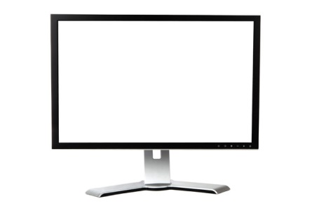
Mirror
Laser
Half wave plate
Laser
Nd:YAG
6.0ns
730 mJ
1064 nm
40 µm Ø
1.3x10¹⁰ Wcm⁻²
1.6x10⁹ Wcm⁻²
Polarizer
Half wave plate
Polarizer
Lens
Plasma
Target
Mirror
Data Acquisition and Analysis
ICCD
Collecting Optics
Shamrock
Fibre Optics

Slide 20
Outline
Introduction
  Research Aim
  Research Objectives
LOD Optimisation
  Introduction
  Experimental Setup
  Results and Discussion
Depth Profiling Using LIBS
  Introduction
  Experimental Setup
    Results and Discussion
Conclusion
Future Work

Slide 21
Typical Spectrum
Al I 3s²4s to 3s²3p
Al I 3s²4s to 3s²3p
Si I 3s²3p4s to 3s²3p²
Si I 3s²3p4s to 3s²3p² at 390.55 nm
Al I 3s²4s to 3s²3p at 394.40 nm
Al I 3s²4s to 3s²3p at 396.15 nm

Slide 22
Aluminium Intensity at Higher Power Density (1.3 x10¹⁰ Wcm⁻² )
1 mm
45 µm
30 µm
15 µm
1.5 µm

Slide 23
Silicon Intensity at Higher Power Density (1.3 x10¹⁰ Wcm⁻²
1 mm
45 µm
30 µm
15 µm
1.5 µm

Slide 24
Target thickness | Ablation Count (No of shots)
1 mm ( Red) | _
45µm (Blue) | 33-39 shots
30 µm (Black) | 22-26 shots
15 µm (Magenta) | 9-13 shots
1.5 µm( Green) | 1 shot
Ablation rate =1.3-1.7 µm/shot

Slide 25
Aluminium Intensity at Low Power Density (1.6 x 10⁹ Wcm⁻²).
1 mm
45 µm
30 µm
15 µm
1.5 µm

Slide 26
Silicon Intensity at Low Power Density (1.6 x 10⁹ Wcm⁻²).
1 mm
45 µm
30 µm
15 µm
1.5 µm

Slide 27
Target thickness | Ablation Count (No of shots)
1 mm ( Red)
45µm (Blue) | 74-77 shots
30 µm (Black) | 50-59 shots
15 µm (Magenta) | 23-27 shots
1.5 µm( Green) | 2-3 shots
Ablation rate = 0.51-0.66 µm/shot

Slide 28
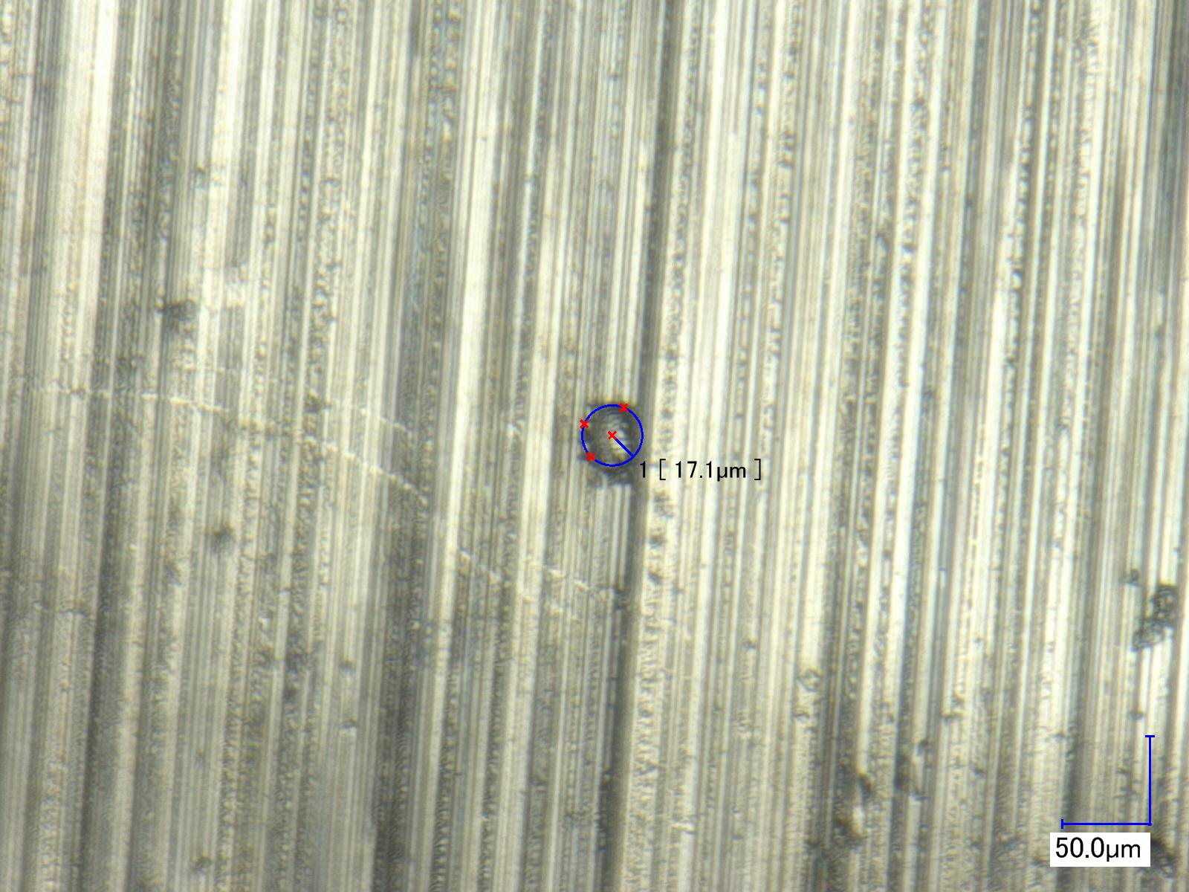
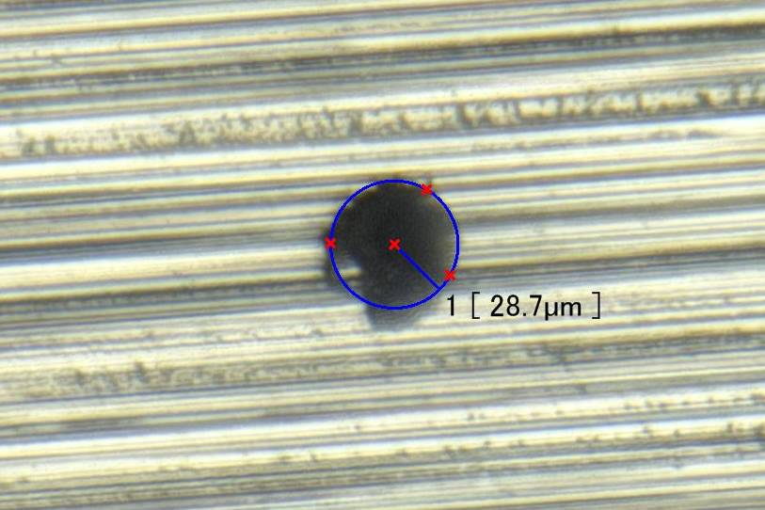
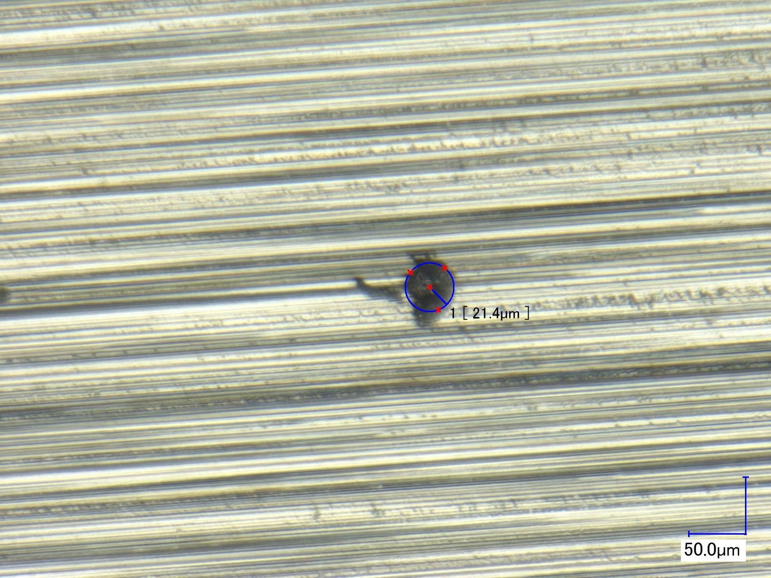
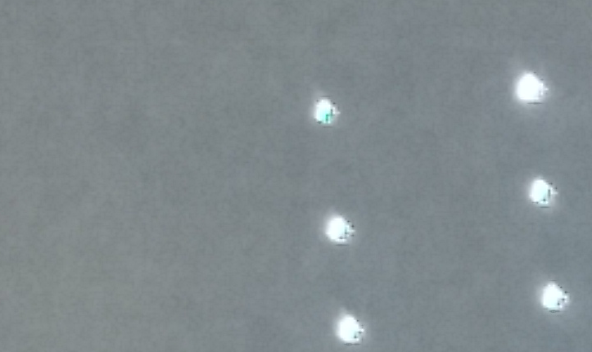
1st shot
After 30 shots
After 15 shots
Light Test 1.5 micron foil

Slide 29
Outline
Introduction
  Research Aim
  Research Objectives
LOD Optimisation
  Introduction
  Experimental Setup
  Results and Discussion
Depth Profiling Using LIBS
  Introduction
  Experimental Setup
  Results and Discussion
Conclusion
Future Work

Slide 30
Time Resolved and Time Integrated LIBS of Aluminum samples is performed at high and low power densities
The ablation rate of Al using low power density is 0.51-0.66 µm/shot
The ablation rate of Al using high power density is 1.3-1.7 µm/shot
Typical Al spectrum with high signal to noise ratio can be recorded with only 10 to 24 shots (in 1-2.4 seconds) using high and low power densities
Initial results encourage to investigate further crater geometry to understand plasma properties, laser material coupling and LIBS emission

Slide 31
Outline
Introduction
  Research Aim
  Research Objectives
LOD Optimisation
  Introduction
  Experimental Setup
  Results and Discussion
Depth Profiling Using LIBS
  Introduction
  Experimental Setup
  Results and Discussion
Conclusion
Future Work

Slide 32
Data Acquisition
ICCD/Scintillator
Spectrometer
Target
Plasma
GCA
GCA
Parabolic Mirror
Parabolic Mirror
Lens
Pumping system
Laser

Slide 33
Future work
Examine dual pulse LIBS with time resolution for steel and aluminium.
Using Coefficient Correlation method at low Power density to get better signals. (Ref T Nagy et al Applied surface science 2016)
Depth profiling of metallic thin films in Vacuum.
Visit UNIPD under EXTATIC mobility programme –produce and characterise thin films to use in DCU for depth profiling with VUV LIBS.
Using different comparative techniques with LIBS like Secondary Ion Mass Spectroscopy to compare it with LIBS results.

Slide 34
Modules
Completed
FSH502 Extatic Fundamental Module
FSH505 EUV Optics
MM600 Labview, Advance Acquisition of data and Control
CS507A Advanced Statistics and Chemometric
Safelab 1&2 Researcher Module
Enrolled
FSH508 EUV and X-Ray Metrology

Slide 35
Acknowledgement
Paddy Hayden , John Costello, Piergiorgio Nicolosi and Group members NCPST.
Supported by:
Work supported by the Education, Audiovisual and Culture Executive Agency (EACEA) Erasmus Mundus Joint Doctorate Programme Project No. 2012 – 0033.

